Slide 1

Overview of the War with Japan
Presented by:
Richard Koone
Education Coordinator
National Museum of the Pacific War
Fredericksburg Texas

Slide 2
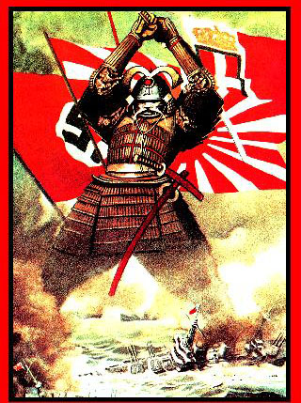
Why Japan decided on War
Expansion
Resources
1894: Sino-Japanese War
1904-05: Russo-Japanese War
1918: Seizure of German possessions
1931: Manchuria
1937: China
Notes:
The Japanese, who had once respected and feared China, saw what the Europeans were doing in China and realized if they did not modernize their military the Europeans would overrun them also. After modernizing their military, the Japanese went to war with China in 1894 and seized Taiwan and Korea. Ten years later they defeated the Russians, destroying the Russian fleet and pushing them out of Manchuria. During World War I Japan joined the Allies. This allowed them to seize the German possessions in the Pacific which included the Marshall, Caroline, Mariana, and Palau Islands. After the First World War, Japan governed those islands under a League of Nations mandate. In 1931 Japan invaded and conquered Manchuria and in 1937 invaded China. These aggressive actions on the part of Japan turned the world against her.

Slide 3
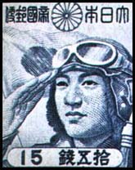
Japan moves
towards War
Notes:
Japan resigns from the League of Nations following condemnation and in July, 1939 the U.S. terminates the U.S.-Japanese commerce treaty.
In 1940 Japan, Germany and Italy form the Axis powers and the U.S. embargoes scrap metal and gasoline and closes the
Panama Canal to Japanese shipping. In 1941 Japan occupies French Indochina and the U.S. institutes a complete oil embargo. Japan decides to “go south” to seize the Dutch East Indies, an area rich in resources. Additional attacks would be made to neutralize U.S. and British military forces in the Pacific, including Singapore and Pearl Harbor.

Slide 4
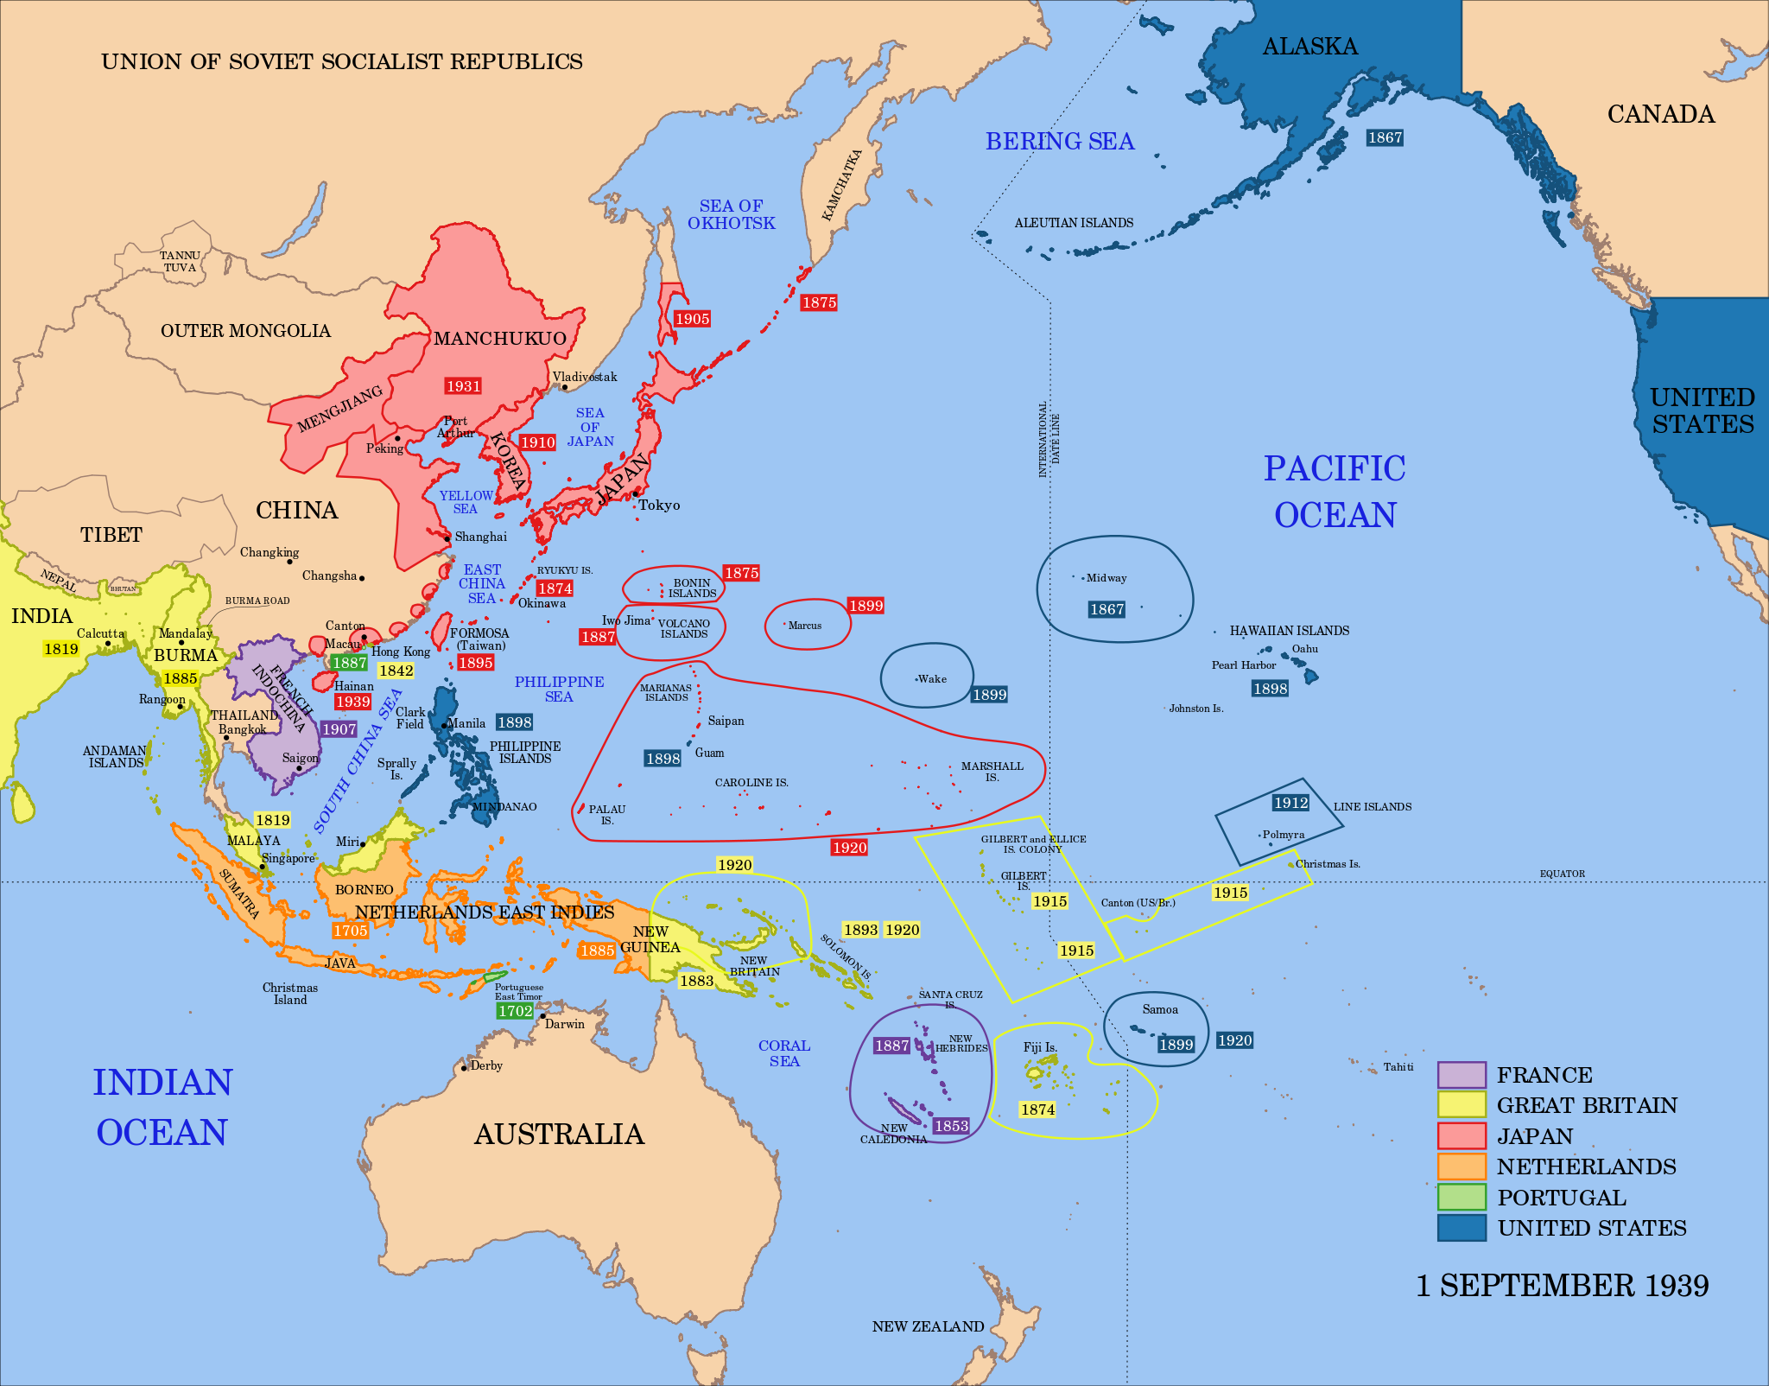
Notes:
This map shows the Pacific as it looked in 1939. The red area is that already controlled by Japan. The purple area is a French possession, yellow – British, orange – Dutch, green – Portugese, and blue – American.

Slide 5
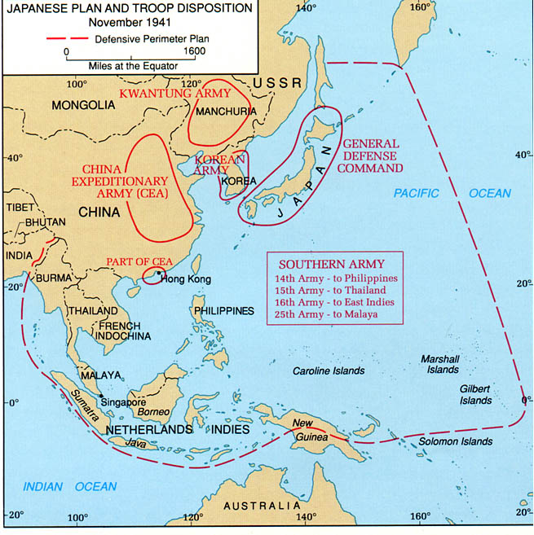
Notes:
The month before the attack on Pearl Harbor, the Japanese had finalized their plans. They would begin the war with an attack on Pearl Harbor followed by invasions of the Philippines, Thailand, the Netherlands East Indies, and Malaya.

Slide 6
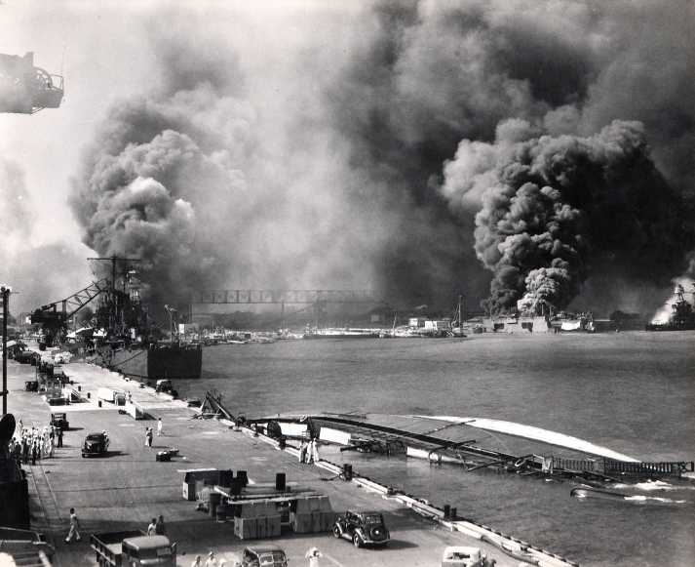
The Attack on Pearl Harbor
Notes:
The attack on Pearl Harbor was launched from six aircraft carriers that had crossed the Pacific undetected. They struck early on Sunday morning, December 7th 1941.

Slide 7
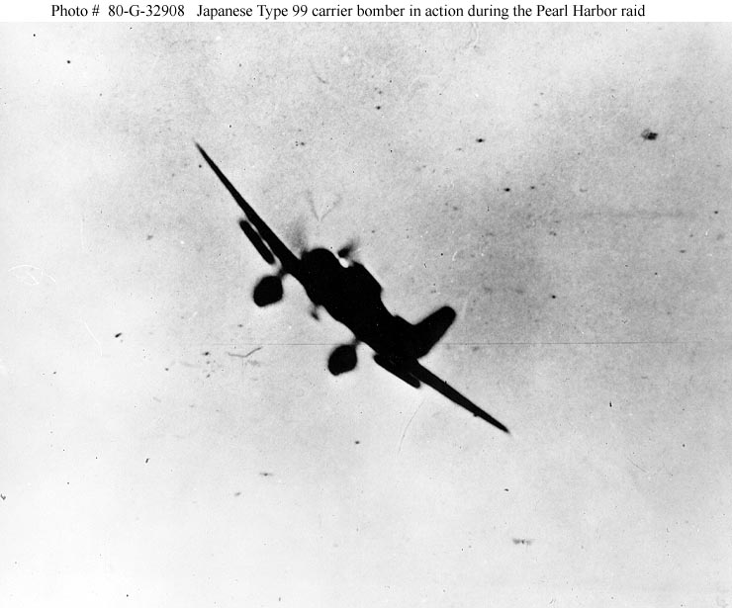
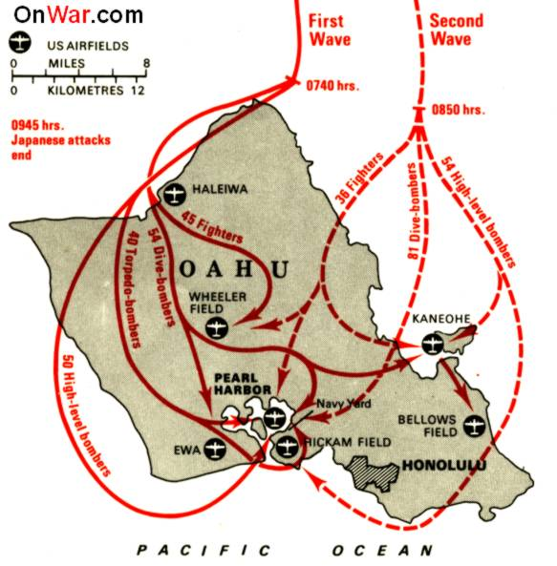
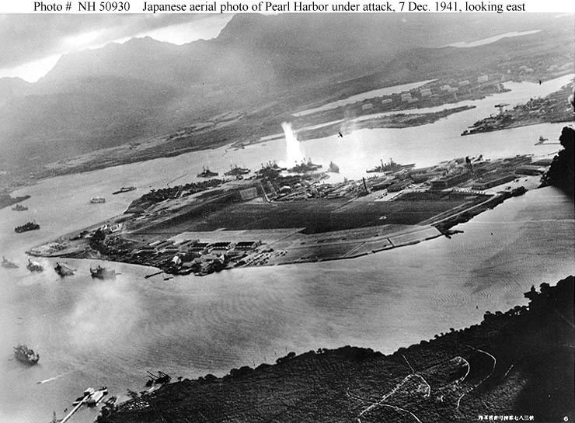
“Air raid Pearl Harbor,
this is no drill”
Notes:
Two waves of Japanese aircraft hit Hawaii, attacking the airfields, the fleet anchorage, and the Navy Yard.

Slide 8
Aircraft Losses U.S. - 169 lost, 159 damaged. Japanese – 29 lost.
U.S. Materiel losses
Battleships:
4 sunk, 4 damaged (all but 2 were repaired and rejoined the fleet)
Cruisers:
3 damaged
Destroyers:
4 damaged
Minelayers:
1 sunk, repaired and rejoined the fleet
Auxiliaries:
2 sunk, 2 damaged (all but 1 were repaired and rejoined the fleet)
Notes:
The U.S. suffered tremendous losses at Pearl Harbor. The fact that they were in the harbor though, allowed most of the ships to eventually be repaired.

Slide 9
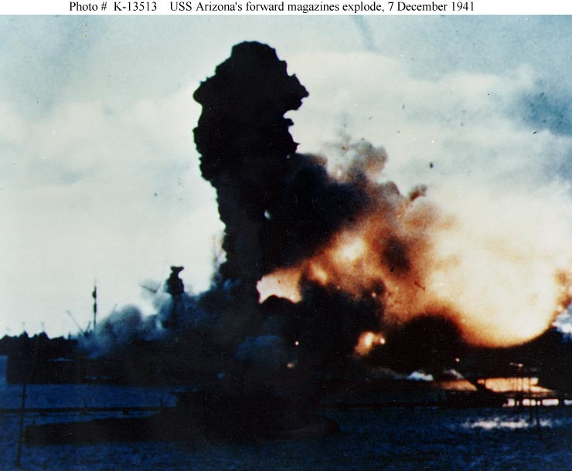
U.S. Personnel losses
2403 killed, including 68 civilians (1102 aboard the USS Arizona)
1178 wounded
Notes:
A bomb penetrated and exploded in the forward powder magazine of the USS Arizona, dooming her and most of the men aboard.

Slide 10
December, 1941
Japanese take Wake Island
Japanese attack
Pearl Harbor, Guam,
The Philippines, Wake
Island, Malaya, Thailand
Shanghai and Midway
Japanese
invade
Burma
Japanese
invade
Hong Kong
7 8 10 11 16 18 22 23 25 26
US and Britain
declare war on
Japan
Japanese
invade
British
Borneo
Hong
Kong
surrenders
Japanese invade
the Philippines and
take Guam
Japanese invade
Luzon in the
Philippines
Manila declared
an open city
Notes:
This timeline shows the extent of the Japanese preparations. They hit fast and hard all over the western Pacific.

Slide 11
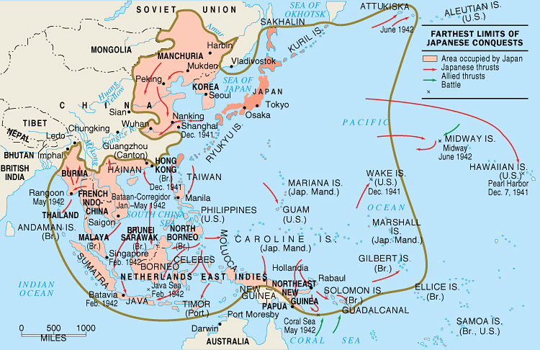
Notes:
By mid-1942, the Japanese had expanded out to their maximum limit. They had plans to go further, but were stopped in a series of naval battles in May and June 1942.

Slide 12
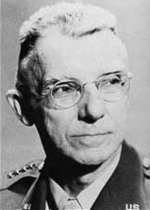
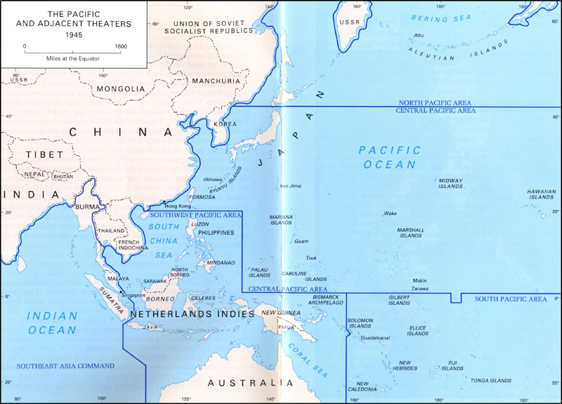
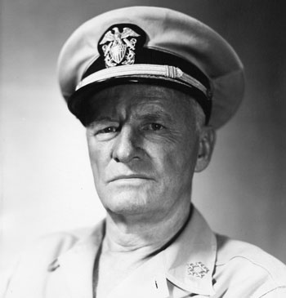
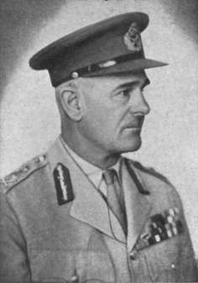
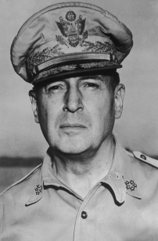
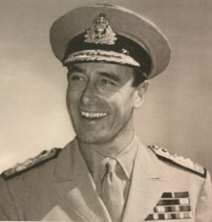
Allied Theater Commands mid-1942
Stilwell
Nimitz
Wavell
Then
Mountbatten
MacArthur
Notes:
In March 1942 the fight against Japan was divided up into various commands. The British had command in the Southeast, the Americans had the rest. General Joseph Stilwell, known as “Vinegar Joe” commanded the China-Burma-India Theater, General Douglas MacArthur commanded the Southwest Pacific Area, and Admiral Chester Nimitz commanded the Pacific Ocean Areas which was further subdivided into the North, Central, and South Pacific.

Slide 13
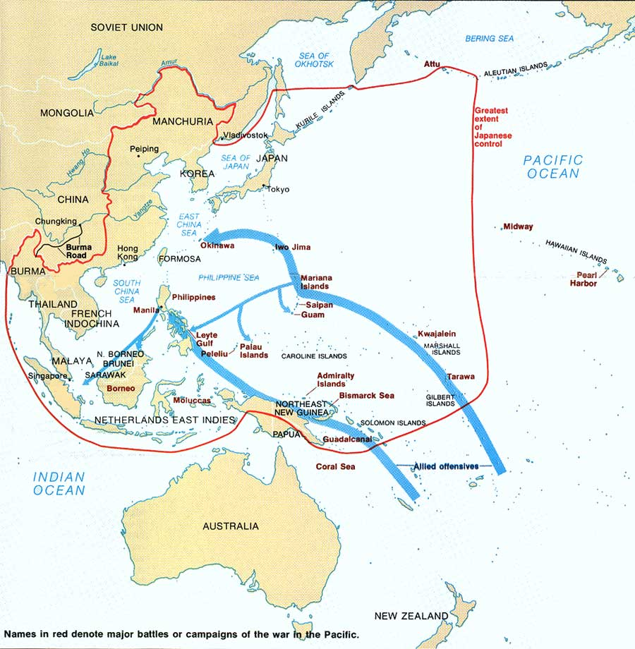
Notes:
The American plan in the Pacific would follow two routes; MacArthur moving up through the Solomon Islands and the northern coast of New Guinea to the Philippines, and Nimitz through the central Pacific to Okinawa. From there, the next step would be an invasion of Japan itself.

Slide 14
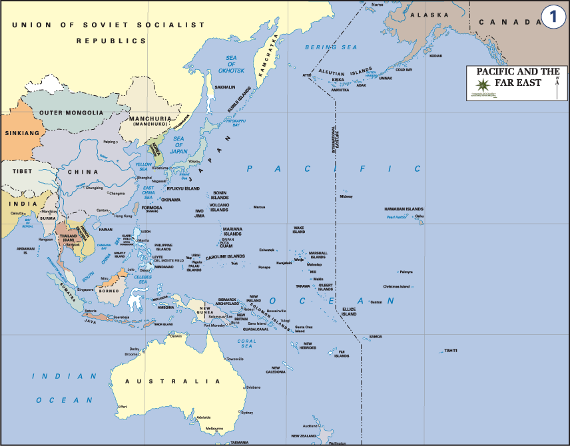
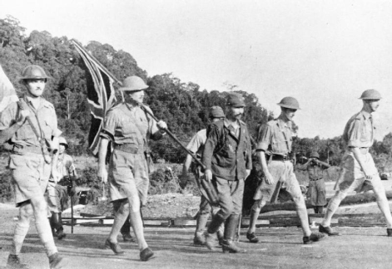
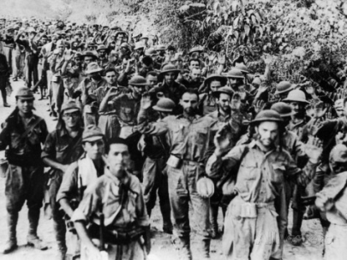
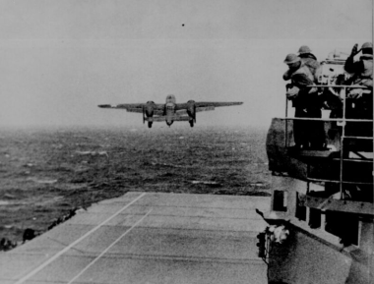
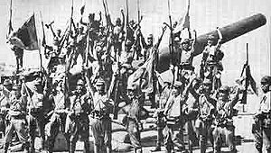
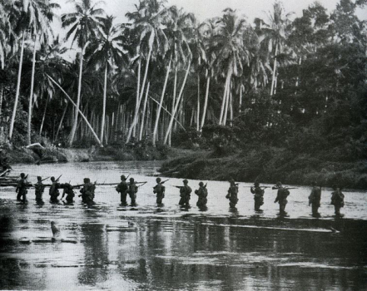
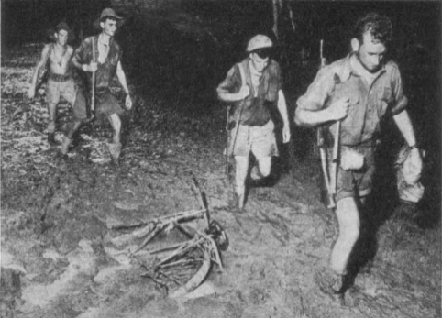
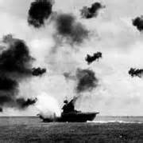
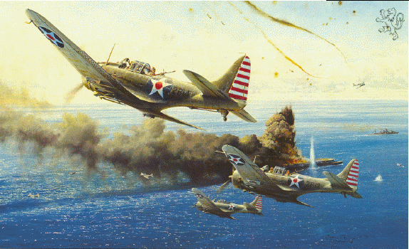
June: Midway
August: Guadalcanal
September: Port Moresby
1942
February: Singapore surrenders
April: Bataan Falls, Doolittle Raid
May:
Corregidor Falls,
Coral Sea
June: Midway
August: Guadalcanal
September: Port Moresby
Notes:
The first six months of 1942 saw the Japanese continuing to push out across the Pacific. In Malaya, the Japanese battled down the Malay peninsula eventually attacking the British island fortress of Singapore. The 80,000 British and Commonwealth troops at Singapore surrendered in February. The following month the 15,000 U.S. and 60,000 Filipino defenders on Bataan, in the Philippines, surrendered. They were then forced to march over 60 miles, with little food or water, to a prison camp. Thousands died on what is known as the Bataan Death March. April saw one bright point for the United States as USAAF B-25 bombers, under the command of Jimmy Doolittle, took off from an aircraft carrier and bombed Tokyo and four other Japanese cities. In May, Corregidor, the island fortress that guarded the entrance to Manila Bay fell and all remaining U.S. forces in the Philippines surrendered. That same month, the Japanese attempted to launch an amphibious landing at Port Moresby, an Australian and U.S. base on the south side of New Guinea. They were turned back in the Battle of the Coral Sea, the first time in history that two opposing fleets fought each other with only aircraft from their carriers. In June the Japanese attempted to capture Midway Island. Our Navy codebreakers had broken the Japanese Navy’s secret code and knew they were coming. In the resulting Battle of Midway, although we lost one aircraft carrier, we sank all four of the Japanese carriers. It was a major blow and is considered a turning point in the war against Japan. In August we launched our first offensive action in the Pacific when we invaded the island of Guadalcanal in the Solomons. The battle would last for six months and end in a U.S. victory. After their failed attempt to take Port Moresby from the sea, the Japanese attacked over the mountains along the Kokoda Trail. They got near the port but the Australians pushed them back. By the end of the year Australian and U.S. forces had fought across the mountains and were near the Japanese bases of Buna and Gona on the north coast of New Guinea.

Slide 15
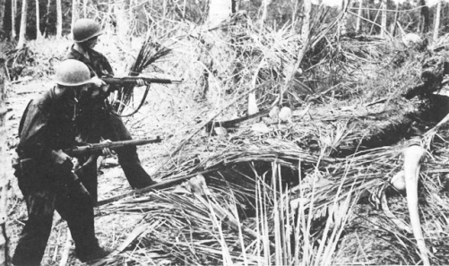
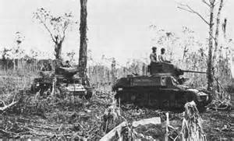
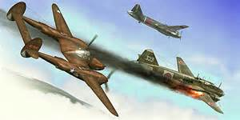
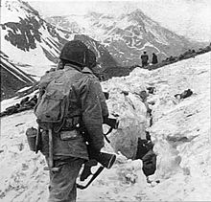
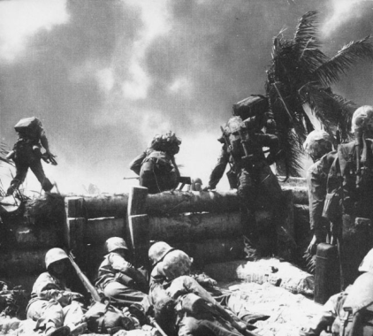
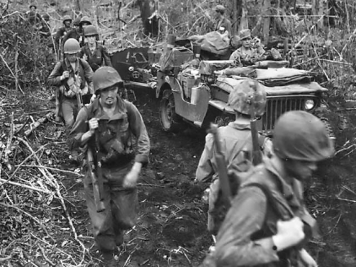
1943
January: Buna
February: Solomons
April: Yamamoto
May: Attu
November: Tarawa
December: New Britain
Notes:
1943 opened with the U.S. and Australian forces taking the Japanese bases at Buna and Gona on New Guinea after a long fight. In February the Japanese withdrew the last of their forces from Guadalcanal and the U.S. began and a year long offensive up the Solomon Island chain with significant battles on New Georgia and finally on Bougainville in November. In another code-breaking effort we discovered that Admiral Yamamoto, the head of the Japanese Navy in the Pacific, would be visiting forward bases and we sent 16 long-range P-38 fighter planes to intercept his plane and shoot him down. In May, U.S. Army troops recaptured the island of Attu, in the Aleutian Islands, which had been taken by the Japanese in June 1942. In the Central and South Pacific Nimitz continued to build his forces until, in November, he launched his first strike into the Central Pacific, taking Makin and Tarawa atolls in the Gilbert Islands. This was his first step of his island-hopping campaign across the Pacific. During the year, General MacArthur continued his plan to isolate the large Japanese base at Rabaul on the island of New Britain. In coordination with the forces moving up the Solomons chain, MacArthur’s forces moved up the northern coast of New Guinea. In December he landed troops at Cape Gloucester on the opposite end of New Britain from Rabaul. The year ended with MacArthur poised to complete the isolation of Rabaul and Nimitz about to jump off deeper into the Central Pacific in accordance with their plan.

Slide 16
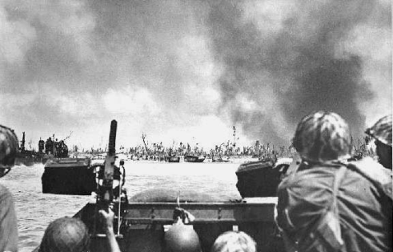
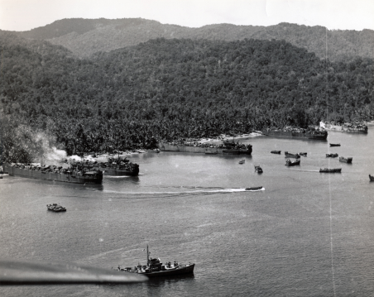
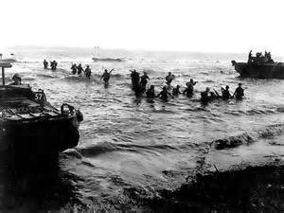
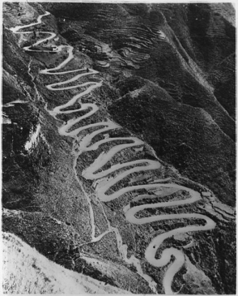
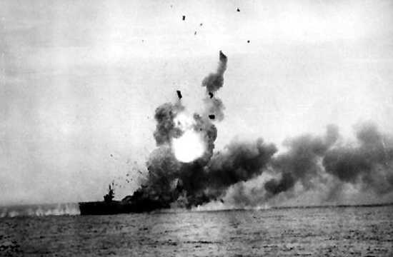
1944
January: Marshalls
April: New Guinea
June: Marianas
August: Burma
October: Leyte Gulf
Notes:
In January Nimitz landed forces in the Marshall Islands taking the atolls of Kwajalein and Eniwetok, this gave him a jumping off point for the next leg of his island-hopping campaign. After seizing the Admiralty Islands in February to finish isolating Rabaul, MacArthur’s forces landed at Hollandia, New Guinea, in April, hundreds of miles behind the Japanese lines. He would continue what he called “leap-frogging” up the New Guinea coast to prepare for his next big jump to the Philippines. In June Nimitz’s forces landed in the Marianas, taking Saipan, Tinian, and Guam, and defeating the Japanese fleet in a major sea battle. Those three islands would soon become major bases for American bombers attacking Japan. In August there was heavy fighting in Burma as the British turned back a Japanese offensive into India and U.S. and Chinese forces pushed the Japanese back in northern Burma to link up with the old Burma Road. This allowed supplies to begin to flow into China once again. In October MacArthur landed at Leyte in the Philippines. This caused the Japanese fleet to come out once again. In the largest naval battle in history, the Battle of Leyte Gulf, the Japanese fleet was destroyed for good and no longer remained a threat. The year ended with U.S. Army troops seizing Mindoro Island as a prelude to their invasion of Luzon, the main island in the Philippines.

Slide 17
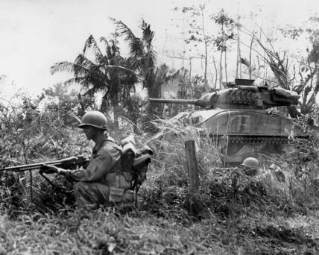
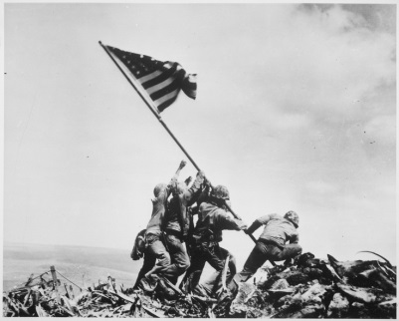
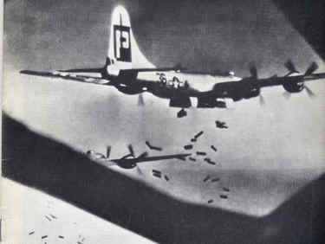
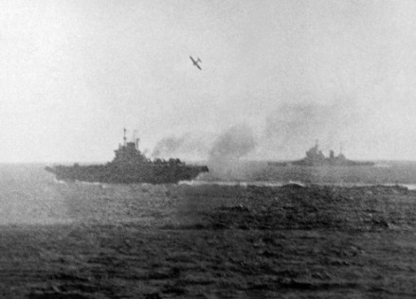
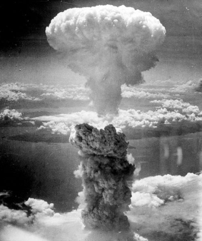
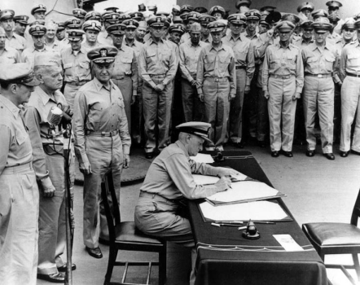
1945
January: Luzon
February: Iwo Jima
March: Tokyo
April: Okinawa
August: Atomic bombs
September: Surrender
Notes:
In January U.S. forces landed on Luzon and quickly drove south to Manila freeing American prisoners and Allied civilians along the way. Manila was liberated after a devastating month long battle. U.S. troops were still fighting Japanese holdouts in the mountains until the end of the war. In February Nimitz’z forces invaded Iwo Jima, halfway between the Marianas and Japan. Mount Suribachi at one end of Iwo Jima was the scene of the famous flag raising photograph. In March the heavy bombers switched from high level daylight raids to low level night raids using incendiaries (fire bombs), in one night they destroyed approximately one third of Tokyo, killing over a hundred thousand Japanese. On April Fool’s Day American forces landed on Okinawa to begin a two and a half long brutal fight to take that island. It was at Okinawa that the Japanese began using large numbers of kamikaze, suicide attacks with airplanes, against the U.S. fleet. The U.S. Navy lost over 30 ships sunk and 100 damaged, along with over 5000 dead, the largest losses ever by the U.S. Navy in a battle. Okinawa fell in June. On August 6th we dropped the first atomic bomb on the city of Hiroshima, the site of the Japanese headquarters that controlled all Japanese forces in southern Japan. Three days later we dropped the second bomb on Nagasaki. These two bombs plus the Soviet declaration of war against Japan convinced their military and civilian leadership that all was lost and surrender was the only alternative. On August 14th the Emperor announced Japan’s acceptance of the surrender terms. The formal surrender occurred on September 2nd aboard the battleship USS Missouri in Tokyo Bay and World War II came to an end.

Slide 18
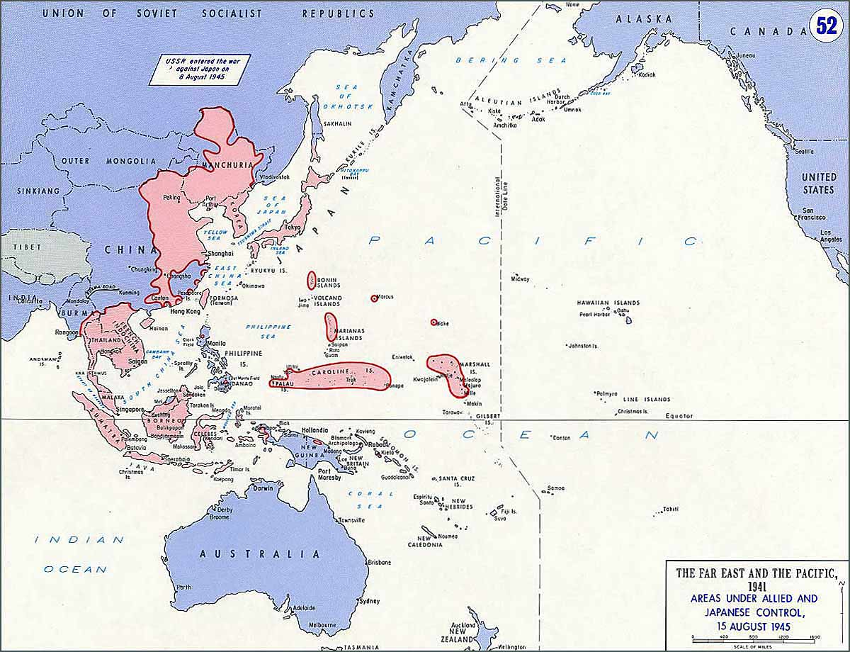
Notes:
There still remained over 5 million Japanese troops all over the Pacific and Asia. The red areas on the map show areas still held by the Japanese when the war ended. They were convinced to surrender by Allied and Japanese officers and by the end of the year most had been repatriated to Japan. U.S. troops were also coming home, in December 1945 alone, 700,000 came home from the Pacific.

Slide 19
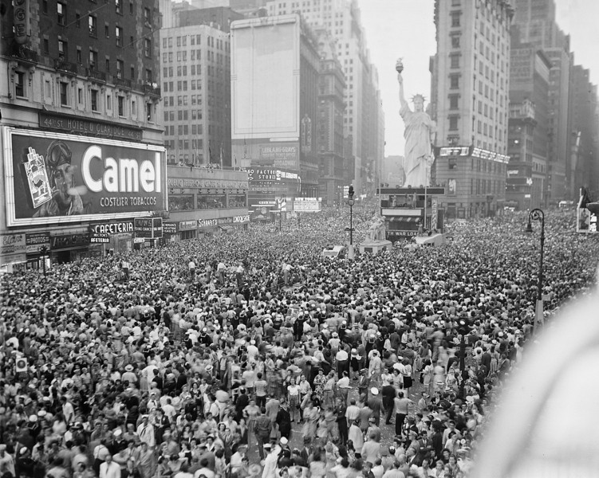
QUESTIONS ?
Notes:
Celebration in New York’s Times Square upon the announcement of the Japanese surrender.

