Slide 1
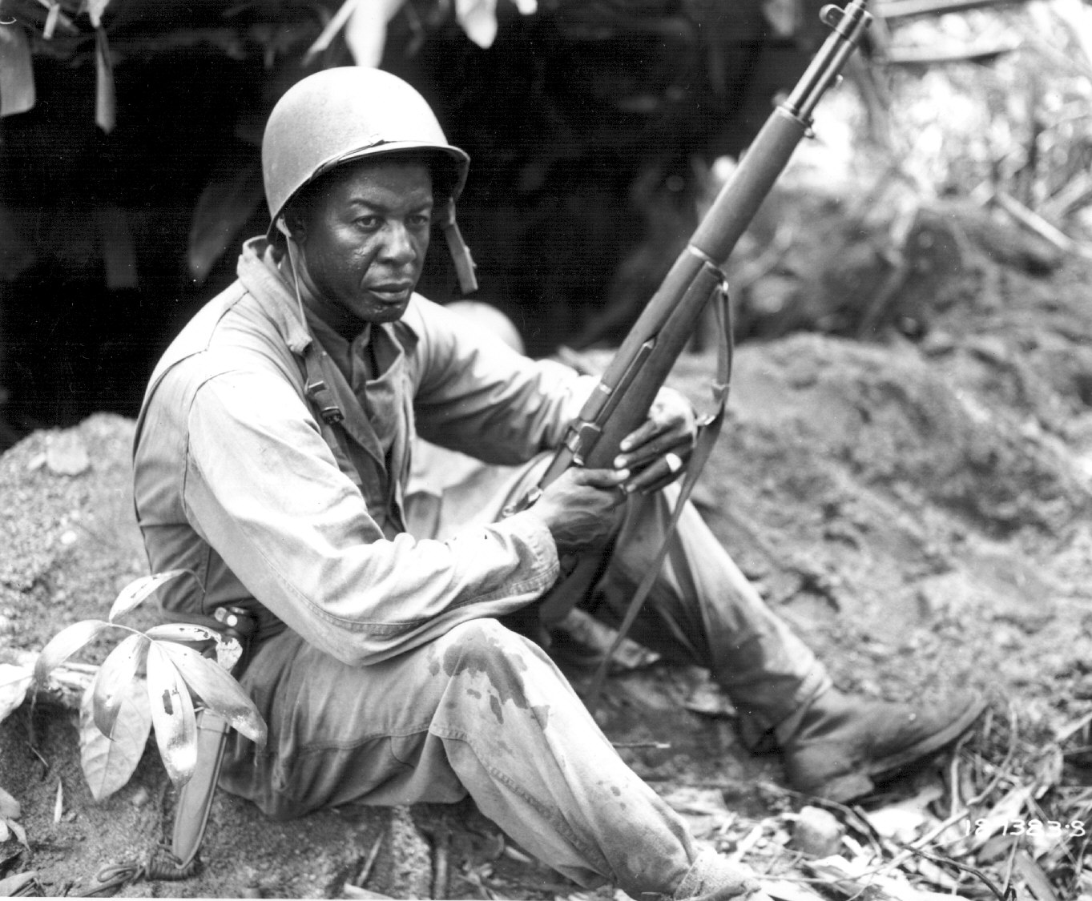
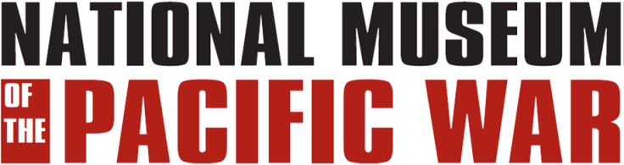
The role of
African-americans
In the pacific
During world war ii
Notes:
The photograph shows First Sergeant Rance Richardson from Arkansas taking a break on Bougainville in April 1944.

Slide 2
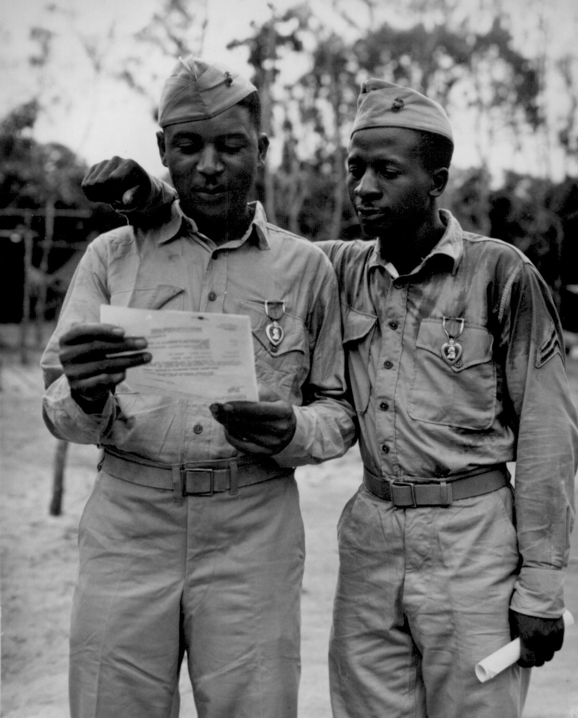
Overview
SERVED IN SEGREGATED UNITS AND HAD SEGREGATED FACILITIES
1.2 MILLION SERVED DURING WWII
MOSTLY SERVED IN SUPPORT AND SERVICE UNITS
Staff Sergeant Timberlate Kervin and Corporal Samuel
J. Love, Sr., the first African-American Marines decorated
by the 2nd Marine Division. They received Purple Hearts
for wounds received on Saipan.
Notes:
Over 2.5 million African-American men registered for the draft, and black women also volunteered in large numbers. While serving in the Army, Army Air Forces, Navy, Marine Corps, and Coast Guard, they experienced discrimination and segregation but met the challenge and persevered. They served their country with distinction, made valuable contributions to the war effort, and earned high praises and commendations for their struggles and sacrifices.

Slide 3
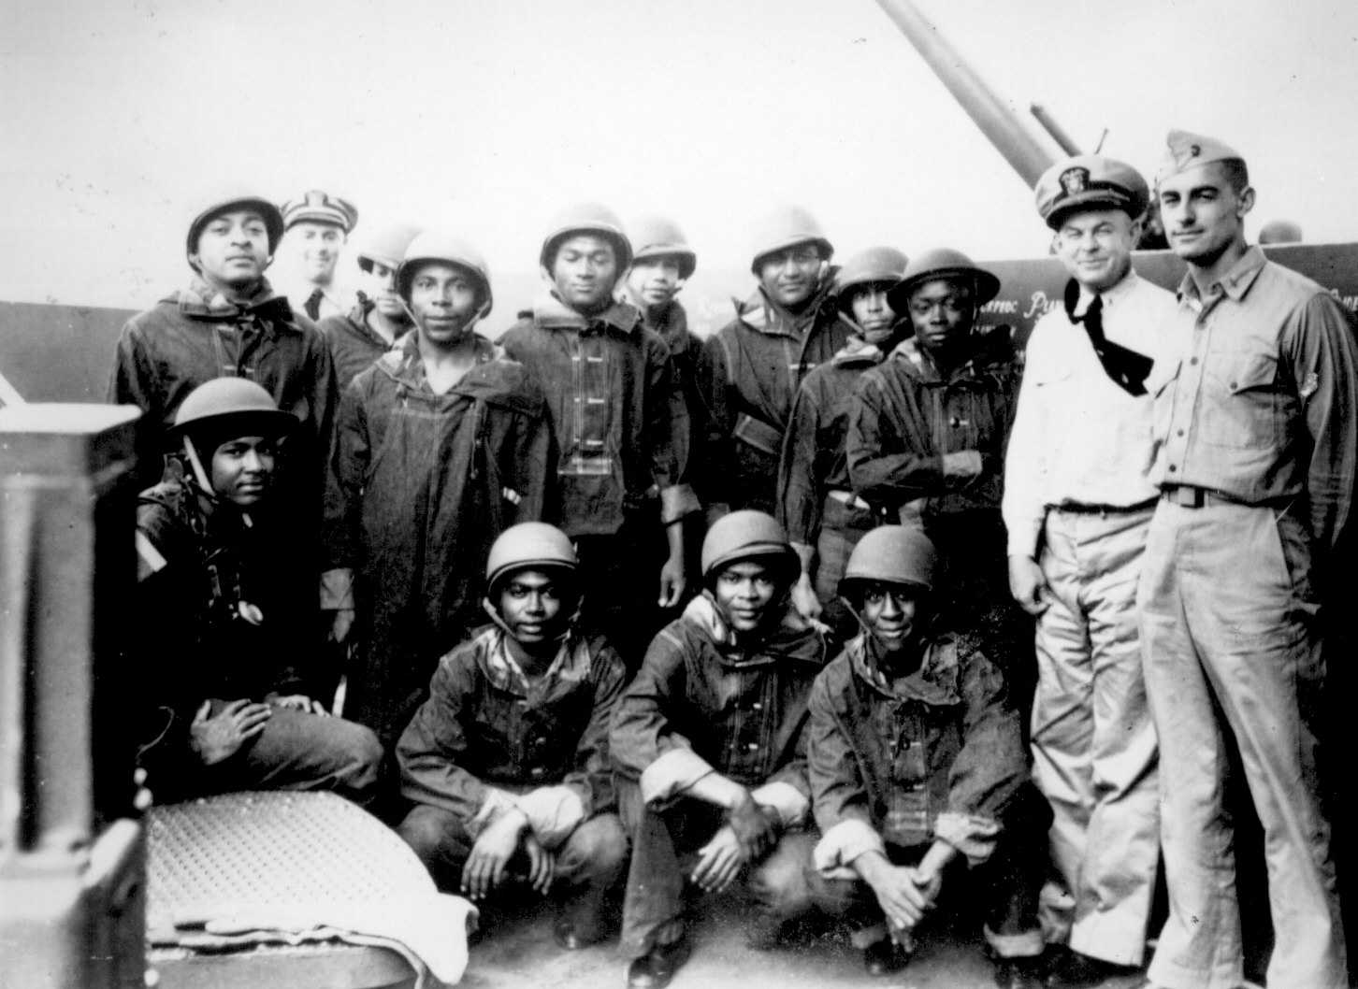
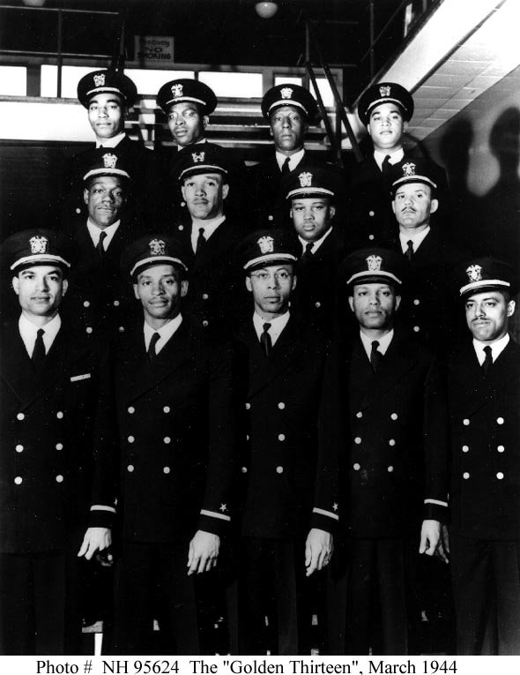
The navy
A gun crew posing for a group photo aboard
their ship.
March 1944, the first thirteen
African-American naval officers
are commissioned.
Notes:
167,000 African-Americans served in the Navy during the war. Aboard ship most served as Mess Attendants and on gun crews. General Service, which meant they could serve in any duty position, opened up for them in 1942. The first African-American naval officers were commissioned in 1944.

Slide 4
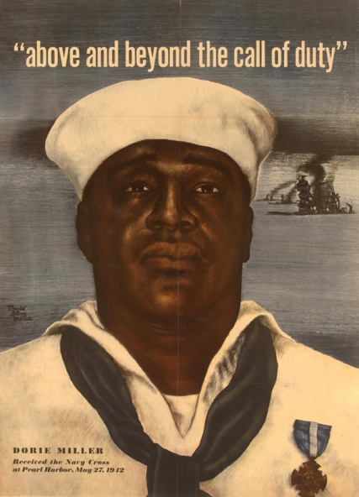
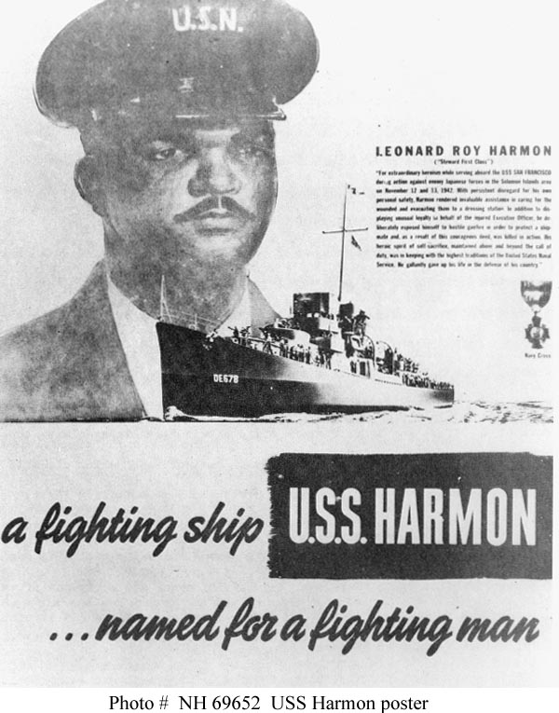
The navy
Doris Miller
Leonard Roy Harmon
Notes:
Of particular interest in Texas are these two gentlemen. On the left is Doris Miller, from Waco, who received the Navy Cross for his actions at Pearl Harbor. His medal was pinned on him by Admiral Chester Nimitz, from Fredericksburg Texas. Doris, known as “Dorie”, would later be killed on 24 November 1943 when his ship, the USS Liscome Bay, was torpedoed and sunk by a Japanese submarine. On the right is Leonard Roy Harmon who was born in Cuero, Texas. Harmon served as a Mess Attendant aboard the USS San Francisco. On 12 November 1942 during the Naval Battle of Guadalcanal, he deliberately placed himself between a pharmacist’s mate who was treating wounded and the enemy fire. In doing this, Harmon was killed. He was posthumously awarded the Navy Cross and had a ship, the USS Harmon (DE-678), named after him. It was the first U.S. warship named for an African-American.

Slide 5
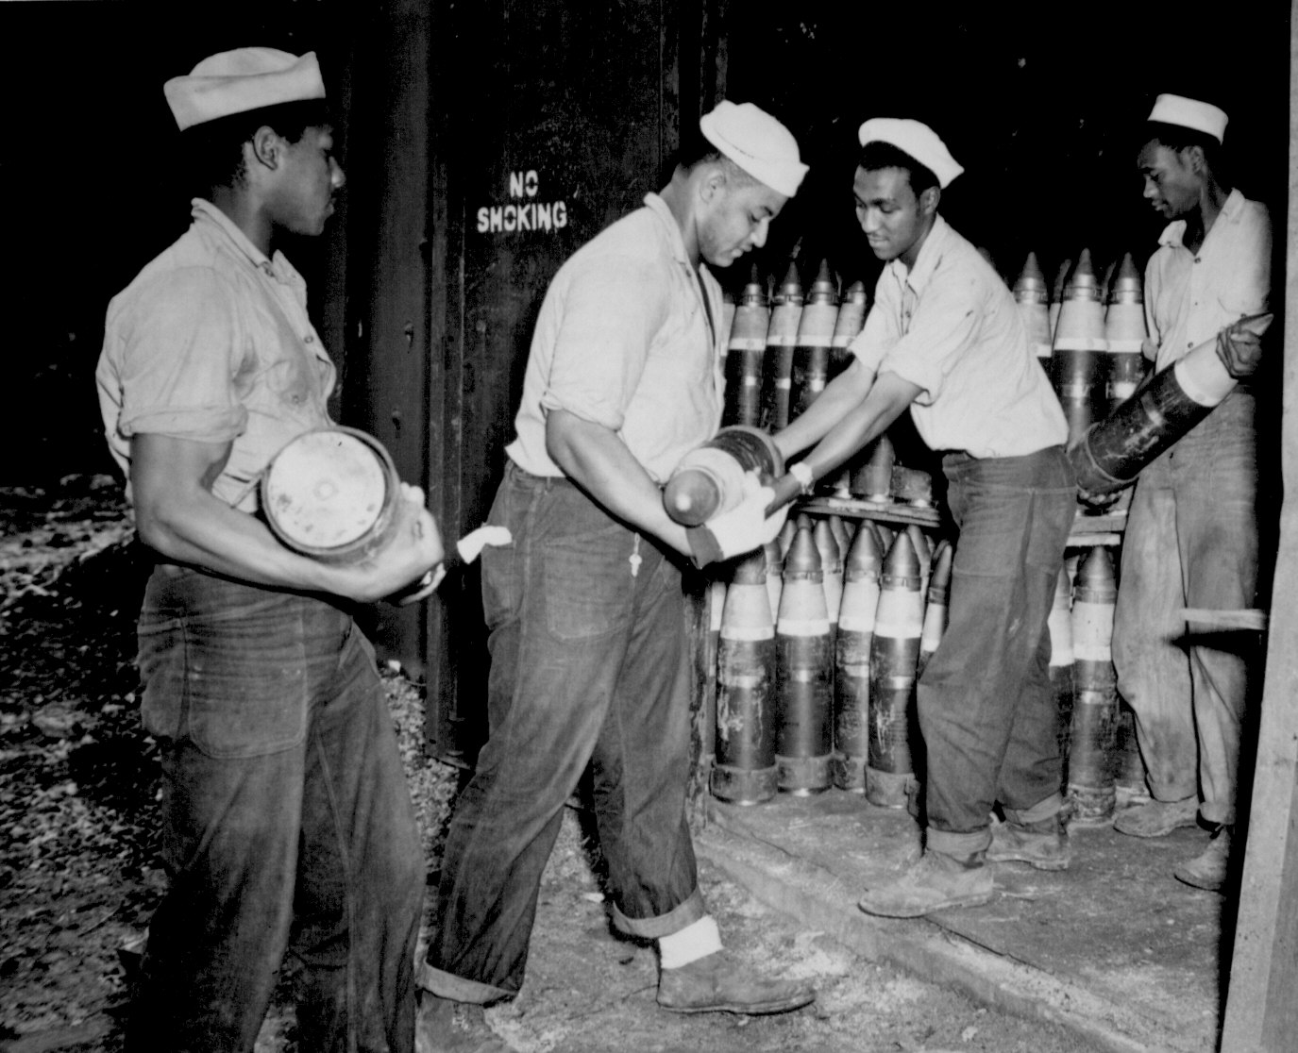
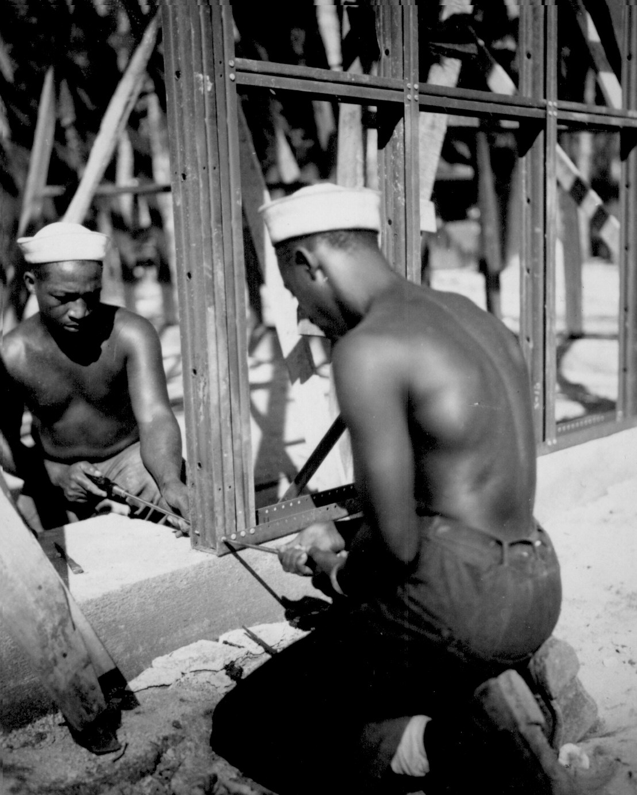
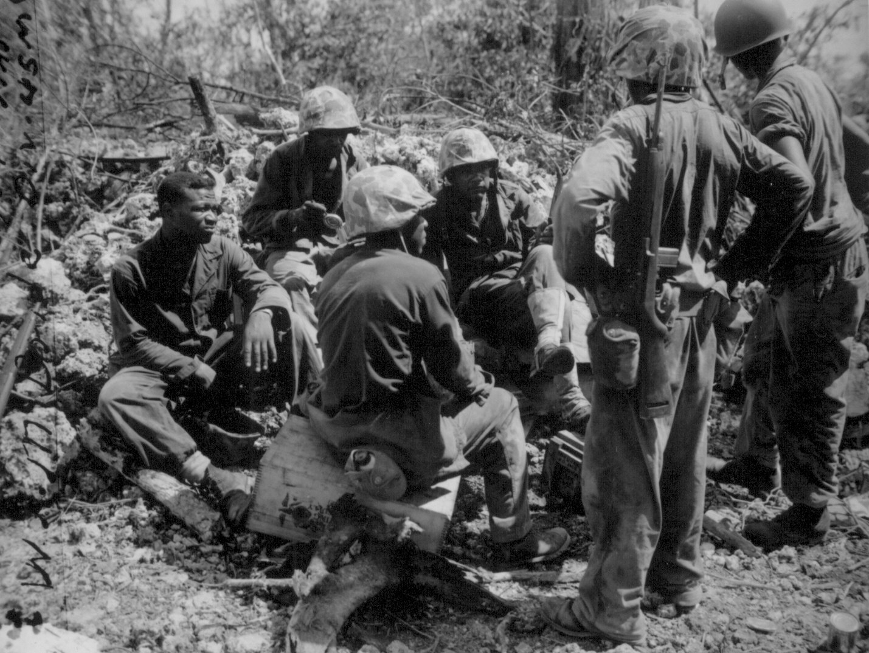
The navy
Storing ammunition
at a naval supply
point.
Taking a break
while unloading
supplies on a
beach.
Building a storage facility
at a rear base.
Notes:
Approximately half the African-Americans in the Navy served ashore at installations, and in logistical and construction units. There were a number of Naval Construction Battalions (Seabees) that were made up of African-Americans. In rear areas they would help build hospitals, roads, warehouses, docks, etc. In forward areas they helped clear beaches, unload ships, and built airfields. At rear bases and installations, logistic units would move and store ammunition, supplies, food, and fuel.

Slide 6
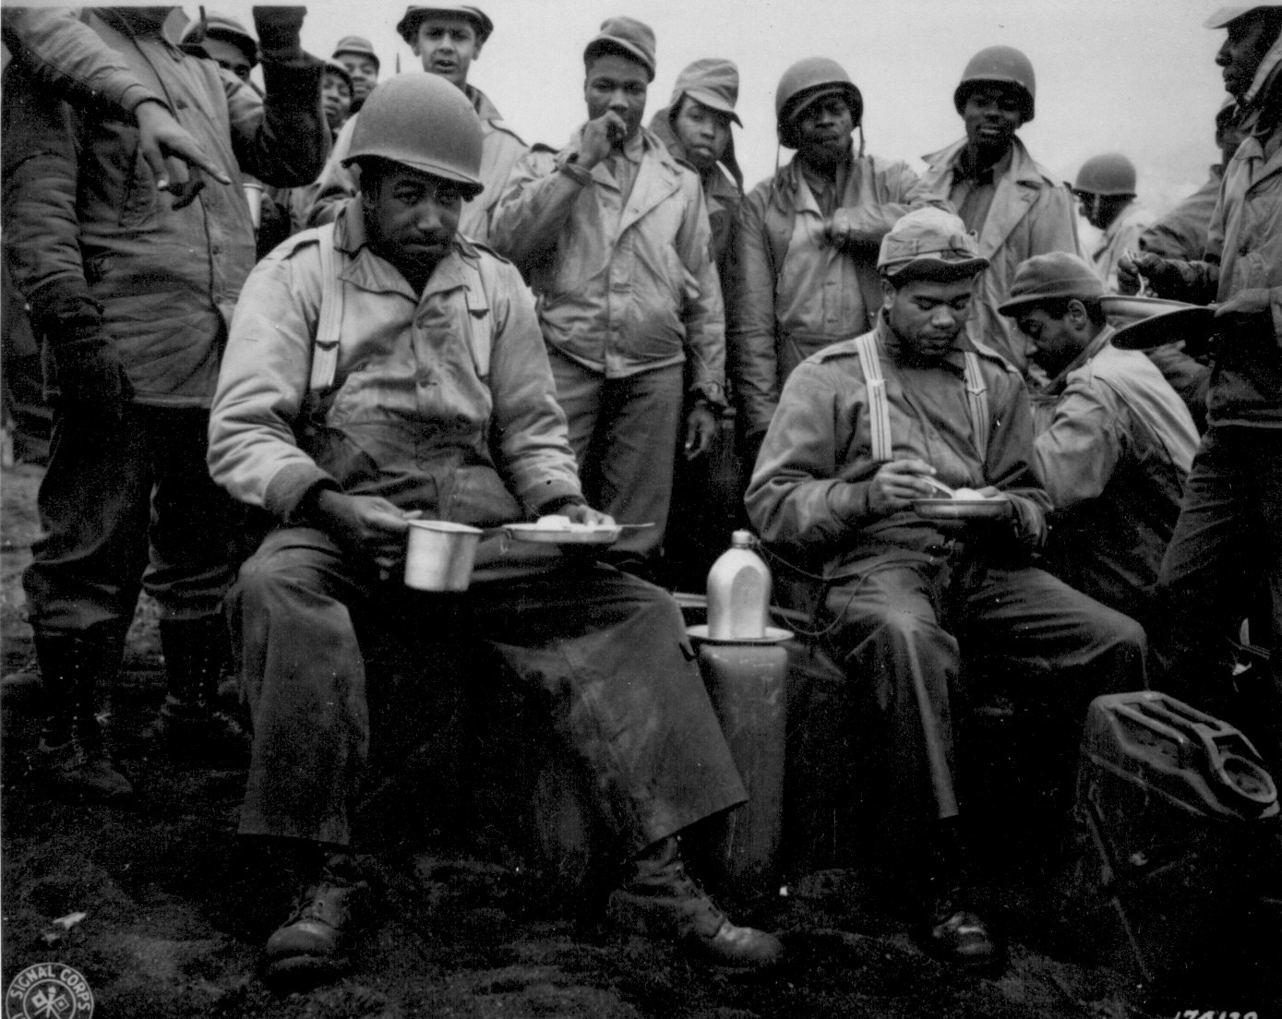
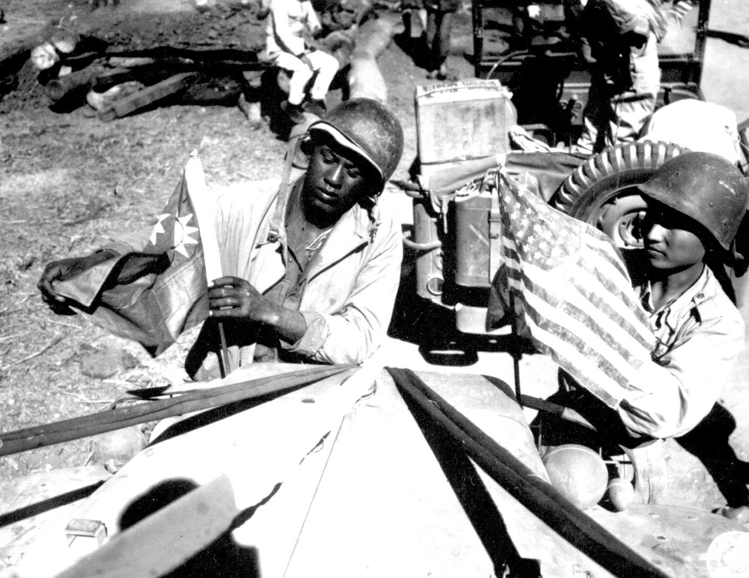
The army
An engineer unit on Attu, in the
Aleutian Islands, takes a break
for chow.
An American soldier and a Chinese
soldier mount each others flag on
the lead truck of the first convoy
to travel the Ledo Road from Burma
to China.
Notes:
909,000 African-Americans served in the U.S. Army during World War II. All served in segregated units. Of these African-Americans in the Army, 78% served in the service branches (Engineer, Quartermaster, and Transportation). The majority of the engineer units that built the Ledo Road from Burma to China were African-American as were many of the transportation units that used the road. Other engineer units served all over the Pacific.

Slide 7
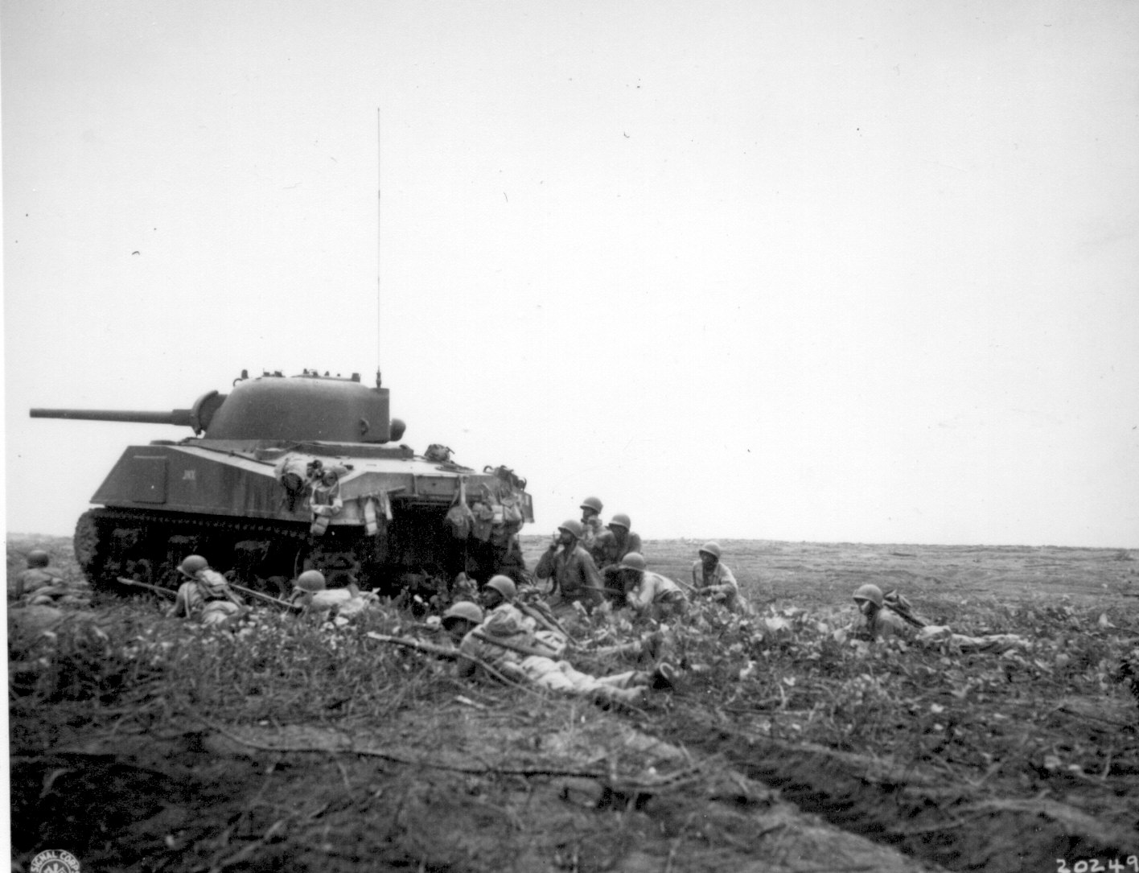
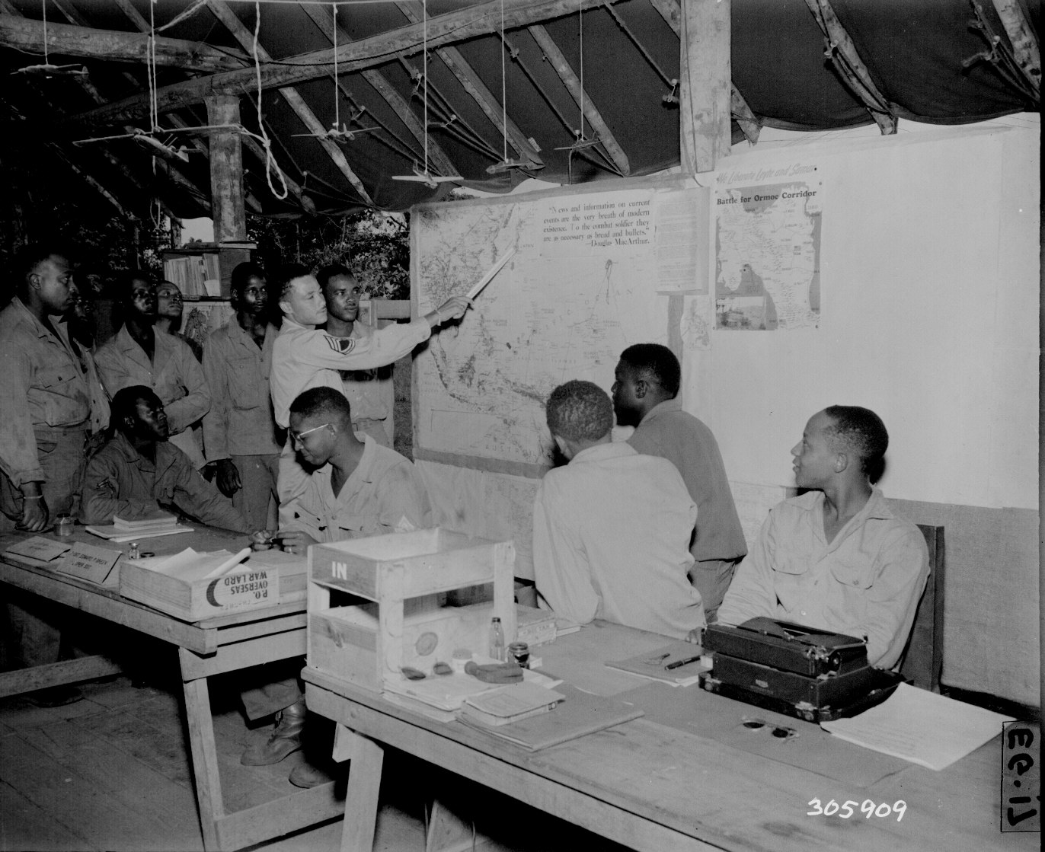
The army
AFRICAN AMERICAN
COMBAT UNITS IN THE PACIFIC
Troops from the 24th Infantry Regiment
supported by a Sherman tank move
towards Japanese positions on the island of
Bougainville.
At the headquarters of an anti-aircraft
battalion, plans are made for the
future deployment of the gun batteries.
Notes:
In the Pacific theater the U.S. Army fielded the following African-American combat units: the 93rd Infantry Division, the 24th Infantry Regiment (a former Buffalo Soldier regiment), ten anti-aircraft battalions, and one coast artillery battalion. The 93rd Infantry Division never fought as a complete division, its regiments, usually in conjunction with the separate 24th Infantry Regiment, would be utilized to conduct mop up operations on many islands and protect bases and airfields near the front. The anti-aircraft and coast artillery battalions protected airfields and bases from Japanese air and naval forces.

Slide 8
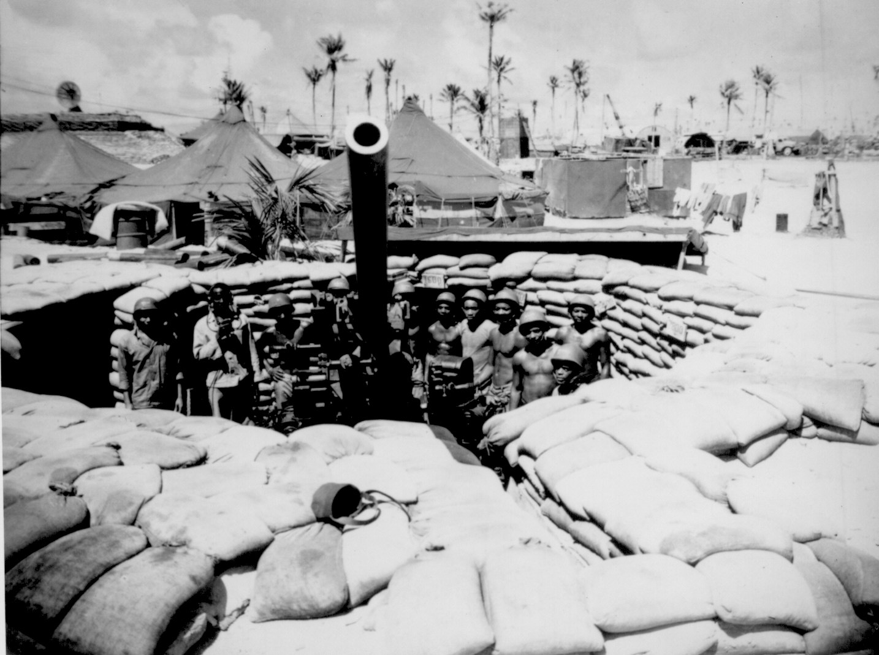
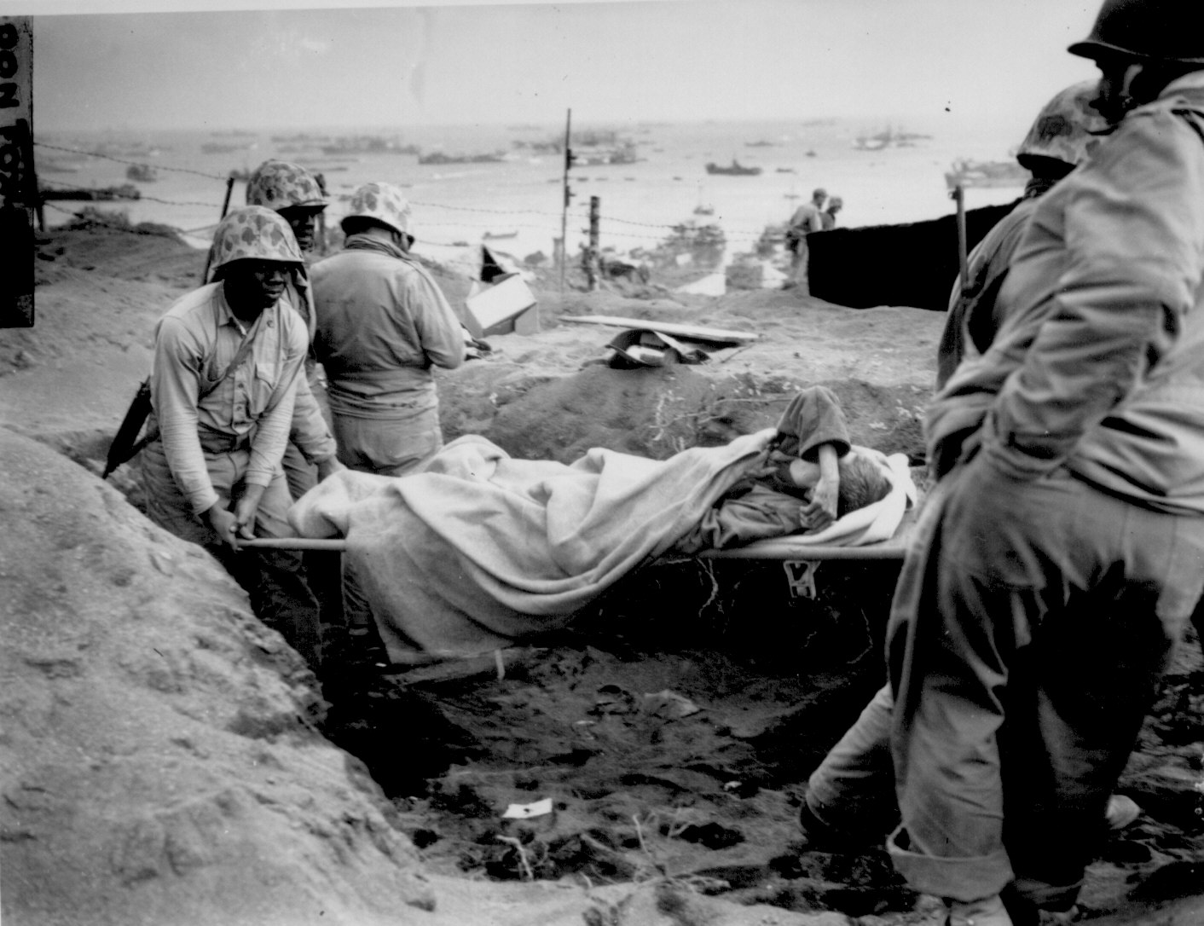
Marine corps
A gun crew from one of the Defense
Battalions poses with their gun on an
island in the Pacific.
Marines from an Ammunition Company
help evacuate a wounded Marine on Iwo
Jima.
Notes:
17,000 African-Americans served in the U.S. Marine Corps during the war. As in the Army, the majority were in support units, mainly in ammunition and depot companies. The Marine Corps formed two combat units of African-Americans, the 51st and 52nd Defense Battalions. These two battalions protected bases in rear areas from Japanese air and naval forces. The Ammunition and Depot Companies landed on islands immediately after the combat troops and in many cases became involved in some fighting against Japanese infiltrators and were subject to enemy artillery bombardments.

Slide 9
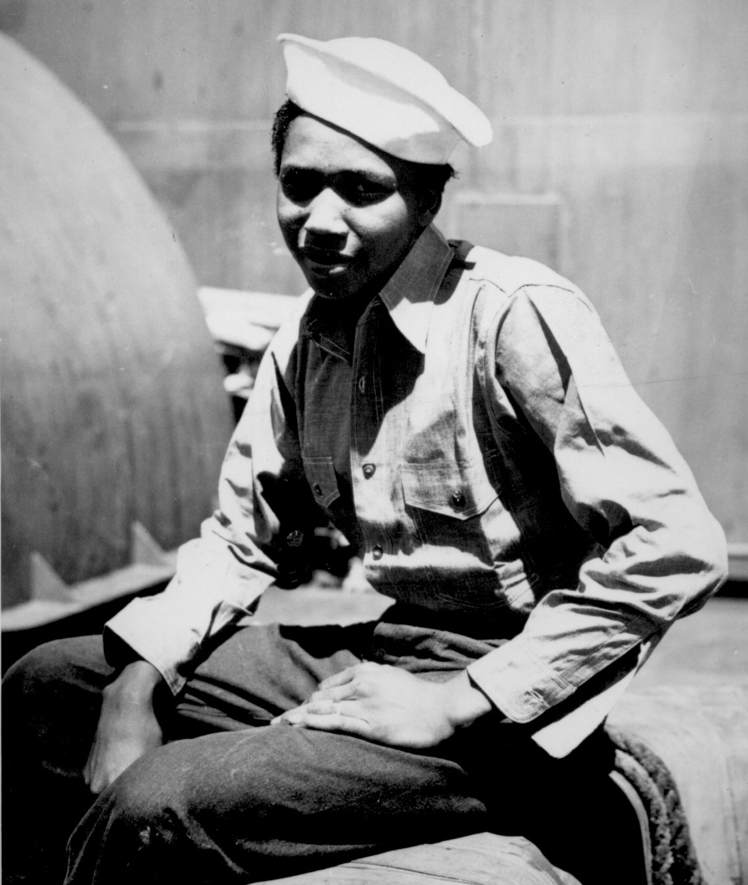
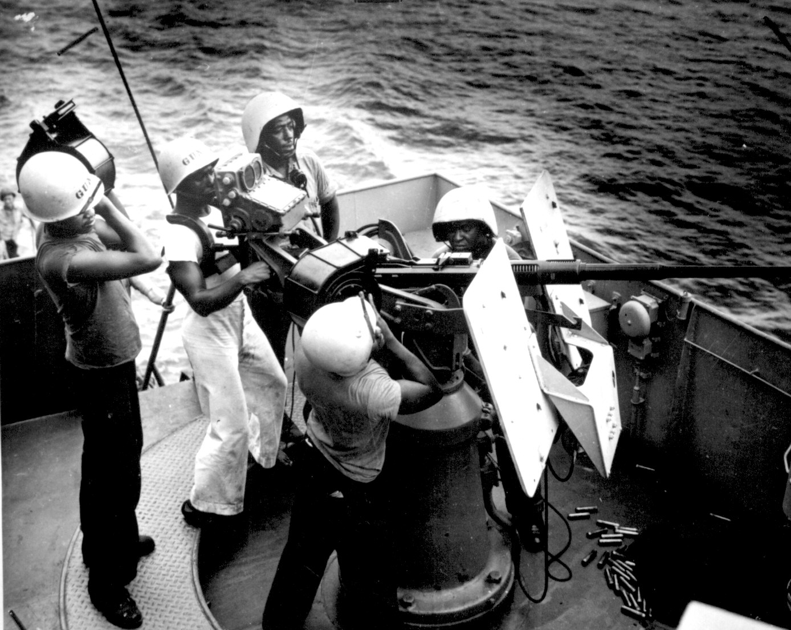
coAsT GUARD
A young Coastguardsman aboard
his ship.
A gun crew loading their 20mm cannon aboard a
Coast Guard frigate in the Southwest Pacific.
Notes:
African-Americans had served in the U.S. Coast Guard for over 100 years prior to World War II. During the war 5000 served in the Coast Guard. 2300 served as Steward’s Mates and gun crewmen aboard Coast Guard manned ships. 2400 served in shore establishments (USCG stations, beach patrols, and headquarters). In 1943 the Coast Guard began a slow integration of ships and the first African-American Coast Guard officer was commissioned that same year.

Slide 10
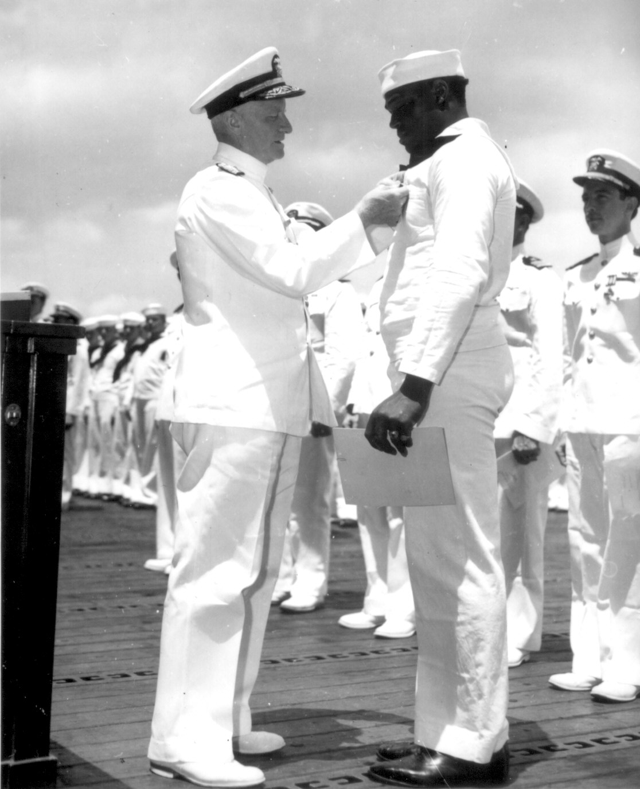
Texas
Admiral Nimitz pins the Navy Cross on Doris Miller. The Navy Cross is the Navy’s second highest award for bravery.
Notes:
80,000 African-American Texans served in the U.S. military during World War II.

Slide 11
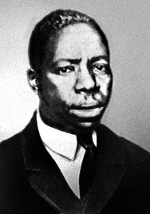
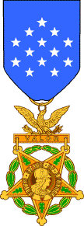
Medal
Of
honor
George Watson (1915 – March 8, 1943)
Notes:
George Watson (1915 – March 8, 1943) was a private in the U.S. Army who was killed in action during World War II. He was one of seven African American soldiers to receive the Medal of Honor for their actions during World War II, and the only one of the seven to earn his medal while serving in the Pacific Theater.

Slide 12
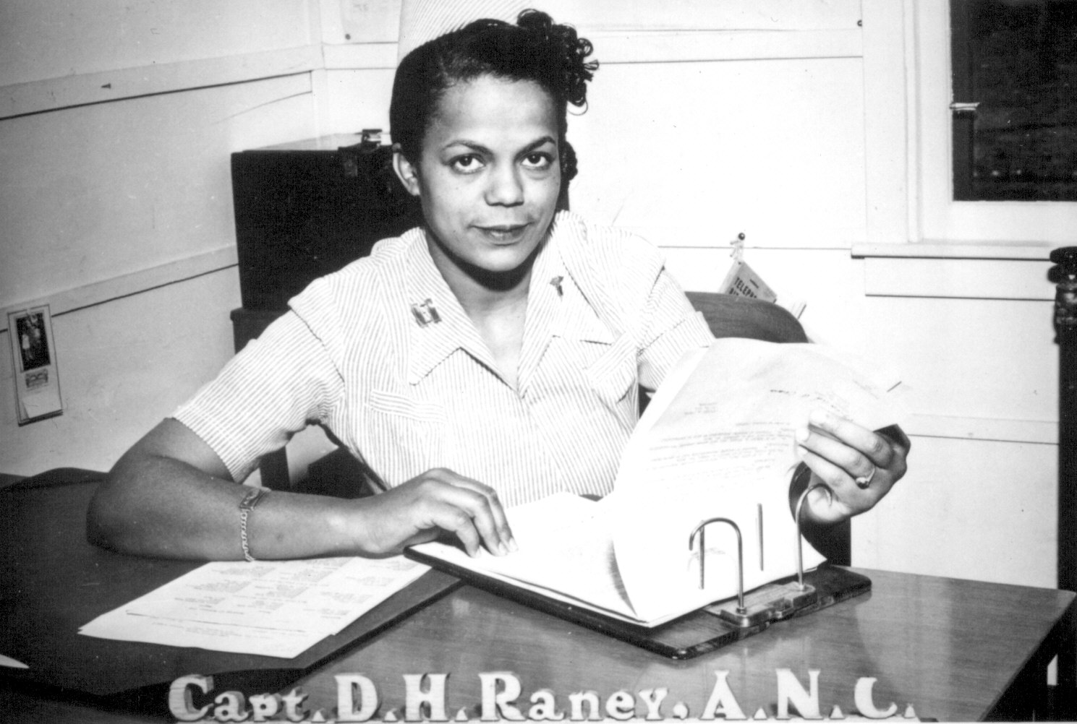
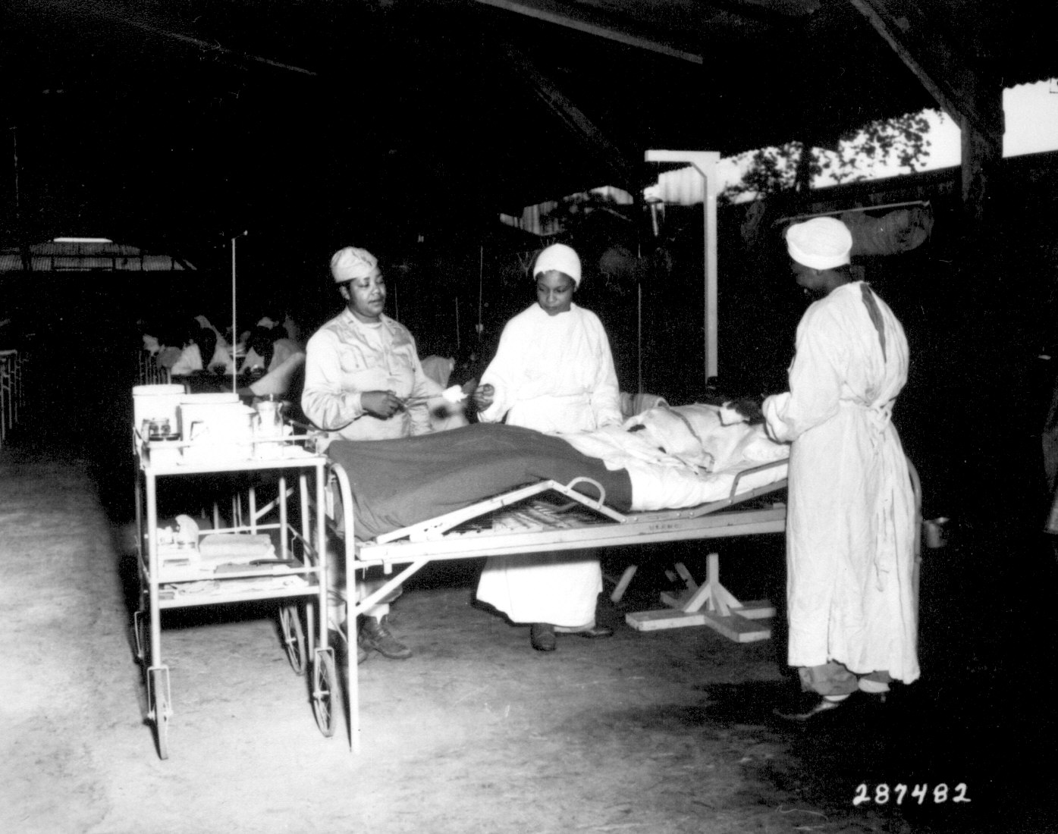
AFRICAN AMERICAN WOMEN
Captain D.H. Raney of the Army Nurse Corps
at her desk at a base hospital.
Nurses tend a wounded patient at
a Field Hospital somewhere in the
Pacific.
Notes:
African-American women served in the military, mostly in traditional jobs held by women at the time: clerical, administrative, and nursing.

Slide 13
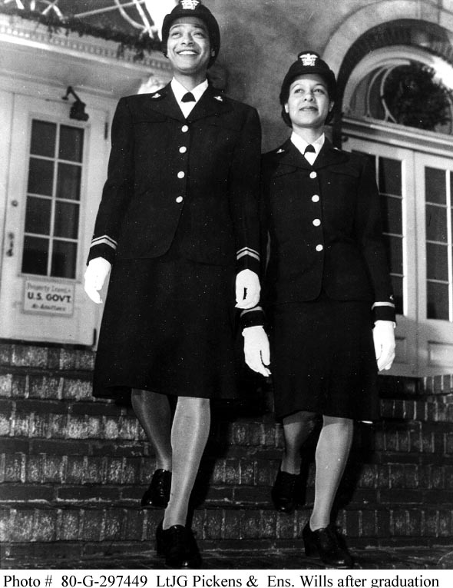
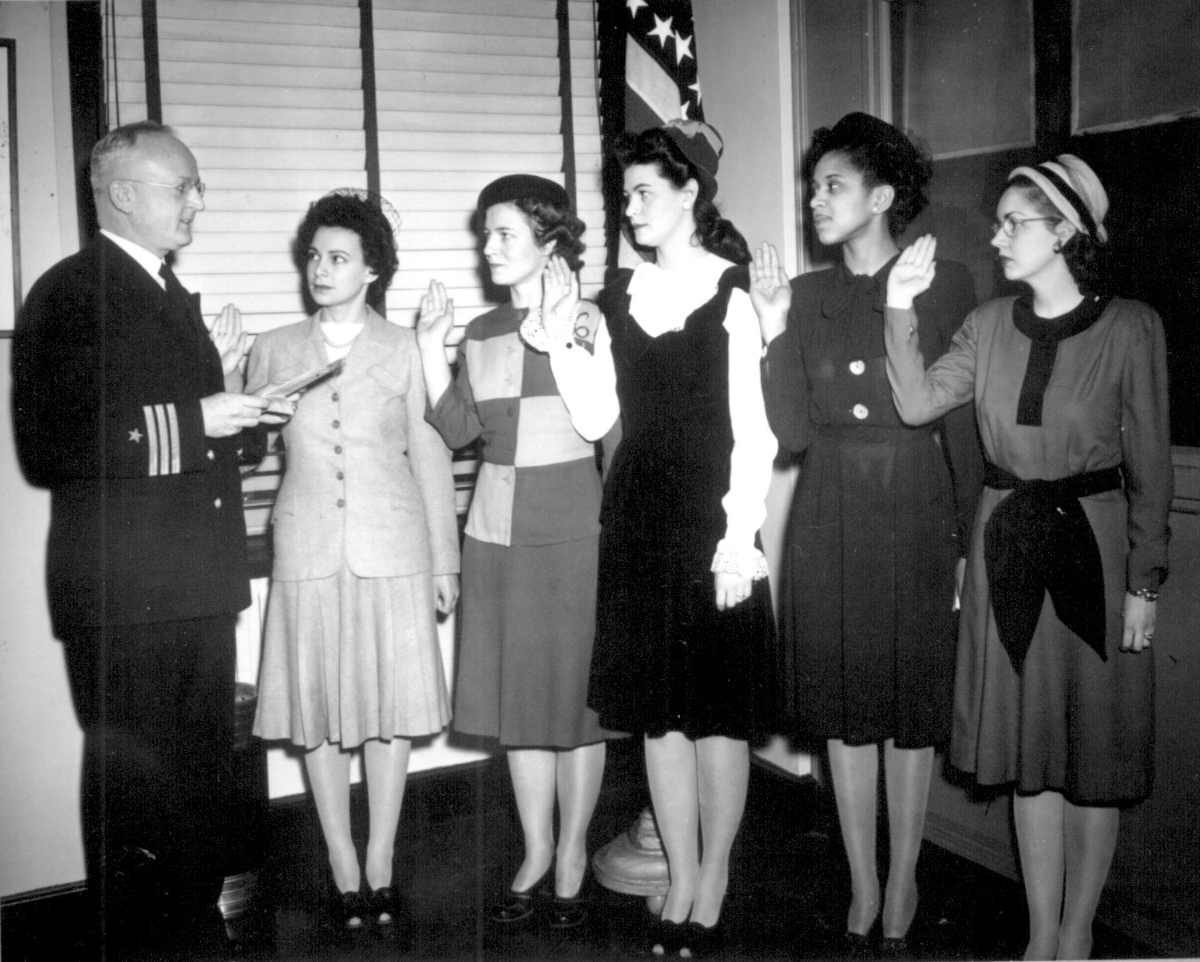
AFRICAN AMERICAN WOMEN
Lieutenant Junior Grade
Pickens and Ensign Wills
after graduation from a
Navy school.
A Navy Commander swearing in a group of
women who are enlisting in the U.S. Navy.
Notes:
African-American women served in all branches of the U.S. Armed Forces during the war.

