Slide 1

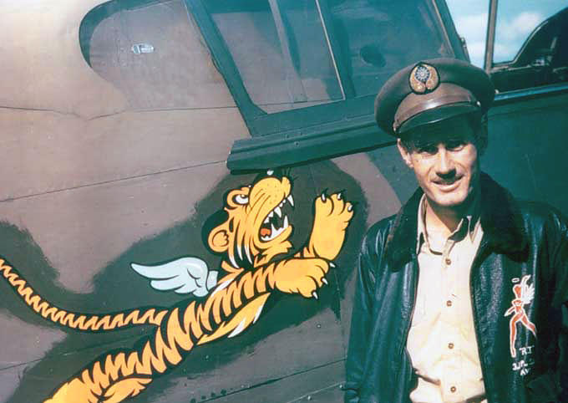
The Flying Tigers

Slide 2
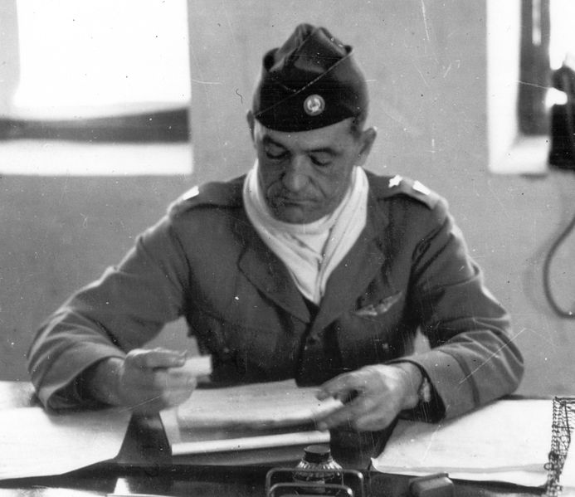
The Origins
Colonel, later General Claire Chennault
Notes:
In 1937, retired Captain Claire Chennault accepted an offer from Madame Chiang Kai-shek to conduct a survey of the Chinese Air Force.
In early 1941, with the approval of President Roosevelt, Chennault began recruiting US military flyers for the American Volunteer Group (AVG), which would later be nicknamed “The Flying Tigers”.
Personnel and aircraft were assembled in Burma and began training.
Their first combat was on 20 December 1941 over Rangoon.

Slide 3
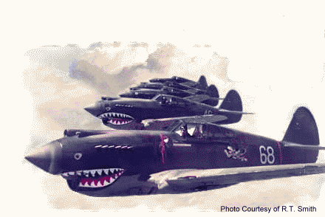
History
Notes:
The AVG was in action for only 7 months: Dec 41-Jul 42.
Using tactics that Chennault learned from his four years in China, they were nearly unbeatable, officially shooting down 300 Japanese planes while only losing 14 of their pilots. During a time of terrible Allied losses around the world, they became famous as a result of their successes.
The shark’s teeth painted on the front of their planes is still one of the most recognized aircraft markings today.
In July 1942 the AVG was incorporated into the USAAF as the 23rd Fighter Group. General Chennault became the commander of the US 14th Air Force in China until 1945.

Slide 4
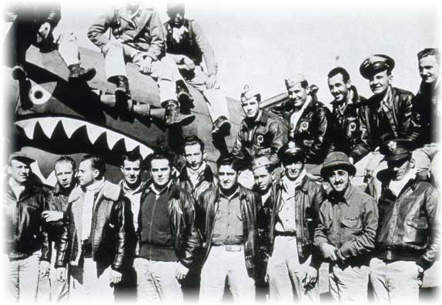
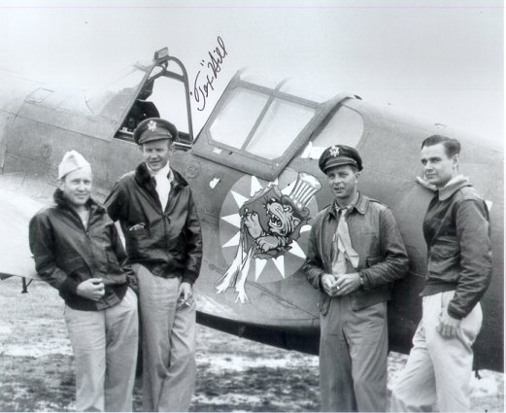
The Men
Photograph signed by Tex Hill,
(second from left).
American Volunteer Group pilots pose in
front of one of their P-40 fighter planes.
Notes:
300 men were initially recruited.
Salaries ranged from $250-$750 a month.
100 of them were pilots, 60 from the USN and USMC, 40 from the US Army Air Corps.
19 pilots became aces (5 or more kills).
David Lee “Tex” Hill, with 10.25 kills, later became commander of the 23rd FG. He retired as a BG in the Texas Air National Guard.

Slide 5
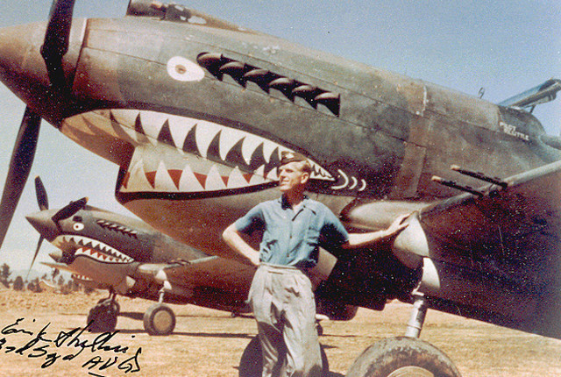
The Planes
Notes:
The Flying Tigers used a variant of the Curtis P-40 Warhawk.
They initially used the Tomahawk IIB, a version built for the British, a variant of the P-40B.
They later received replacements of P-40Es, an improved model of the P-40.

Slide 6
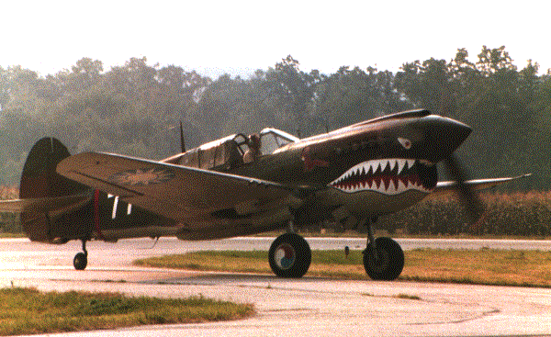
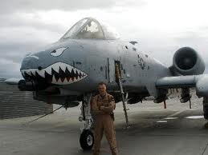
Legacy
Notes:
They were a continuation of a tradition of US airmen who fought overseas for a cause they believed in when the US was not at war:
the Lafayette Escadrille (WWI), the Kosciuszko Squadron (Polish-Soviet War 1919-1921), Yankee Squadron (Spanish Civil War), and the Eagle Squadron (WWII).
Just before their 50th reunion the AVG was recognized as a US military unit and received the Presidential Unit Citation.
Book: God is My Co-pilot.
Movies: Flying Tigers, The Sky’s the Limit, God is My Co-pilot, Hers to Hold, and China’s Little Devils.
Probably the most famous legacy is the continued use of the shark’s teeth on US military aircraft today.

Slide 7
