Slide 1
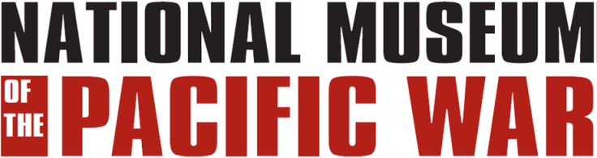
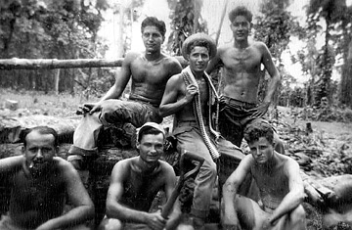
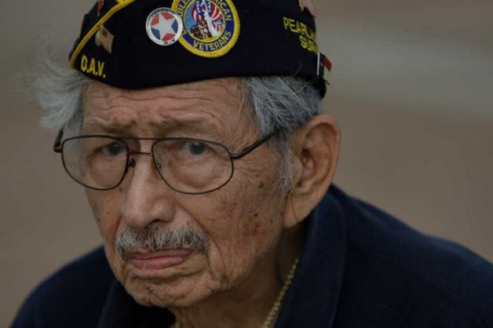
Hispanic americans
In the
Pacific war

Slide 2
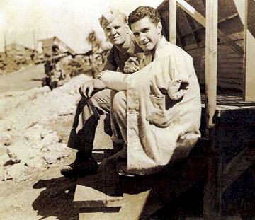
How many served ?
Notes:
An estimated 250,000 to 500,000 Hispanic-Americans served in the U.S. military during world war ii.
Records were not kept because the majority of Hispanics were classified as “white” by the standards of the day.

Slide 3
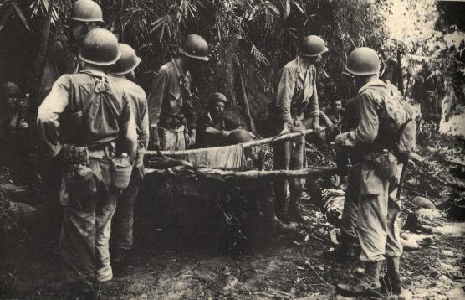
Three units of predominantly hispanic
Personnel Served in the pacific.
The 200th and 515th coast artillery (new mexico national guard)
And the 158th regimental combat team (arizona national guard).
Notes:
The 200th and 515th were both lost in the Philippines upon the surrender of Bataan in April 1942.
The 158th fought in the Southwest Pacific under General MacArthur and saw combat on New Guinea, the Bismarcks,
and Luzon. The unit was nicknamed “the Bushmasters”.

Slide 4
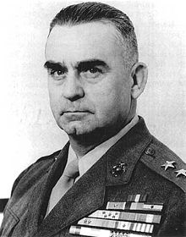
accomplishments
pedro del valle, usmc
Notes:
Pedro Del Valle was the first Hispanic to reach the rank of Lieutenant General. During WWII, General
Del Valle commanded the 1st Marine Division during the battle for Okinawa.

Slide 5
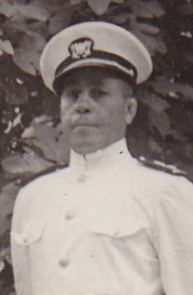
accomplishments
Mario frederic ramirez de arellano
Notes:
Mario Frederic Ramirez De Arellano was the first Hispanic submarine commander.
He took command of the USS Balao in April 1944.

Slide 6
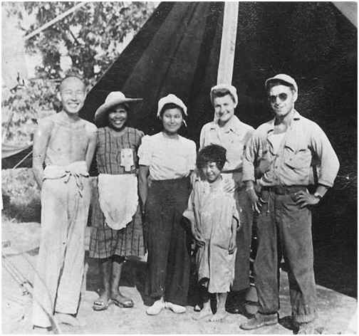
accomplishments
Pfc guy gabaldon, usmc
Notes:
During the battle for Saipan in 1944, he singlehandedly persuaded over 1000 Japanese soldiers and civilians to surrender.
He received the Navy Cross for his actions.

Slide 7
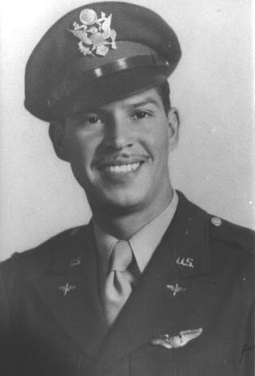
accomplishments
Lieutenant oscar perdomo
Notes:
Lieutenant Oscar Perdomo of El Paso shot down five Japanese planes over Korea on August 13th 1945.
This made him the last ace of World War II.

Slide 8
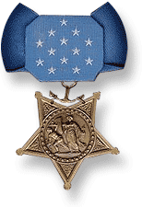
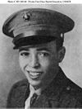
Medal of honor
Harold Gonsalves*: United States Marine Corps. Born in Alameda, California.
Place and Date of Action: Ryūkyū Chain, Okinawa, April 15, 1945
* Awarded posthumously.
Notes:
Of the 13 Medals of Honor awarded to Hispanics, six were awarded posthumously.
Texas accounted for the most Hispanic Medal of Honor recipients in World War II with a total of five.
Seven Hispanic-Americans received the Medal of Honor in the Pacific.
Harold Gonsalves joined the Marine Corps in 1943. He was assigned to an artillery battalion and serving with a forward observer team on Okinawa when a Japanese hand grenade landed among them. PFC Gonsalves jumped on the grenade to protect the others.

Slide 9
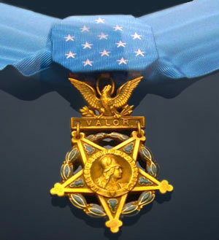
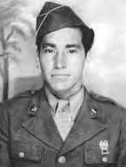
Medal of honor
David M. Gonzales*: United States Army. Born in Pacoima, California.
Place and Date of Action: Villa Verde Trail, Luzon, Philippine Islands, April 25, 1945.
* Awarded posthumously.
Notes:
During the fighting on northern Luzon in the Philippines, an American airplane mistakenly dropped a 500 pound bomb on U.S. positions, burying 5 men. Gonzales and his commander rushed to dig them out. The officer was killed by Japanese fire before they reached the spot but Gonzales kept going. He managed to free 3 of the men before he was also hit and killed by the Japanese.

Slide 10
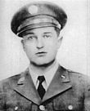
Medal of honor
Joe P. Martinez*: United States Army. Born in Taos, New Mexico.
Place and Date of Action: Attu, Aleutians, May 26, 1943.
Martinez was the first Hispanic American posthumously awarded the Medal of Honor for
combat heroism on American soil during World War II.
* Awarded posthumously.
Notes:
Joe Martinez was assigned to the U.S. Army’s 7th Infantry Division which landed on Attu Island in the Aleutians in May 1943. He personally led two assaults on Japanese positions, inspiring his fellow soldiers to follow him. After personally clearing several trenches he was killed attempting to take the final Japanese position.

Slide 11
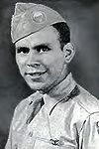
Medal of honor
Manuel Perez Jr.*: United States Army. Born in Oklahoma City, Oklahoma.
Place and Date of Action: Fort William McKinley, Luzon, Philippine Islands, February 13, 1945.
* Awarded posthumously.
Notes:
Manuel Perez was a paratrooper in the 11th Airborne Division. During the fighting in the outskirts of Manila, he single-handedly charged Japanese fortifications killing 18 Japanese before being mortally wounded.

Slide 12
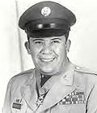
Medal of honor
Cleto L. Rodriguez: United States Army. Born in San Marcos, Texas.
Place and Date of Action: Paco Railroad Station, Manila,
Philippine Islands, February 9, 1945.
Notes:
During the fighting for the Paco Railroad Station in Manila in February 1945, Cleto Rodriguez and a fellow soldier moved forward ahead of their platoon. For the next two and a half hours these two men killed over 82 Japanese soldiers and disrupted the defense of the railroad station. Rodriguez’s companion, PFC John Reese, was killed as they returned to their unit. Both were awarded the Medal of Honor.

Slide 13

Medal of honor
Alejandro R. Ruiz: United States Army. Born in Loving, New Mexico.
Place and Date of Action: Okinawa, Japan, April 28, 1945.
Notes:
Alejandro Ruiz served in the 27th Infantry Division during the fighting on Okinawa. On April 28th 1945 his unit was pinned down by heavy enemy fire from a pillbox. PFC Ruiz charged the pillbox under a hail of machinegun fire and was able to kill its occupants.

Slide 14
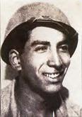
Medal of honor
Ysmael R. Villegas*: United States Army. Born in Casa Blanca, California.
Place and Date of Action: Villa Verde Trail, Luzon, Philippine Islands, March 20, 1945.
* Awarded posthumously.
Notes:
Staff Sergeant Ysmael Villegas was assigned to the 32nd Infantry Division which was attacking up the Villa Verde Trail in northern Luzon in March 1945. He led his squad in an attack to seize a hill. He personally cleared 5 Japanese positions, killing the occupants and was himself killed when he attacked the 6th enemy foxhole.

Slide 15
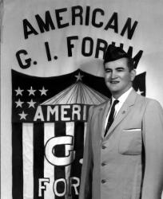
Notes:
After returning home, Hispanic soldiers experienced the same discrimination felt by other Hispanic Americans. According to one former Hispanic soldier, "There was the same discrimination in Grand Falls (Texas), if not worse" than when he had departed. In his town, signs read "No Mexicans, whites only", and only one restaurant would serve Hispanics. The American GI Forum was started to ensure the rights of Hispanic World War II veterans.

Slide 16
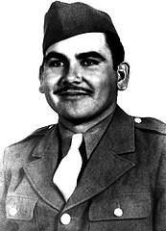
Felix longoria
Notes:
Discrimination also extended to those killed during the war. In one notable case, the owner of a funeral parlor refused to allow the family of Private Felix Longoria, a soldier killed in action in the Philippines, to use his facility because "whites would not like it". Then-U.S. Senator Lyndon B. Johnson and Hector P. Garcia, the Mexican-American World War II veteran who founded the American GI Forum, intervened on Longoria's behalf. Johnson, Lady Bird Johnson, Congressman John Lyle, and President Truman's military aide Gen. Harry H. Vaughan joined the Longoria family for a full military burial with honors at Arlington National Cemetery on February 16, 1949. Johnson stated of the incident, "This injustice and prejudice is deplorable. I am happy to have a part seeing that this Texas hero is laid to rest with the honor and dignity his service deserves.”

Slide 17
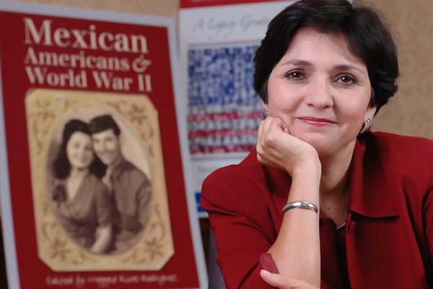
Keeping the memories alive
Doctor Maggie Rivas-Rodriguez
University of Texas, School of Journalism
The US Latino/Latina World War II Oral History Project
Notes:
What began as the US Latino/Latina World War II Oral History Project by Dr. Maggie Rivas-Rodriguez at the University of Texas has now expanded
and includes a project on the Vietnam War and another on Civic engagement. The program is now called “Voces”, Spanish for voices.

