Slide 1
American women
In
World war ii
Notes:
Following World War I, women in the United States experienced some new found freedoms, the right to vote, more liberating fashions and hairstyles, the chance to enter the workforce and gain some economic independence. Then came the Depression in the 1930s, women went to the end of the unemployment lines, states passed laws barring married women from jobs, and it was understood that, “A woman’s place is in the home.” World War II changed all that. As men left for the military their places in factories, defense plants, and industry began to be filled by women. As America became the “Arsenal of Democracy”, more and more women went to work. Thousands of other women joined the military and found experiences unlike any known before by American women. They served in hundreds of different jobs all over the world. They endured the dangers of the battlefield and the boredom of clerical work to help bring about victory. Millions of others cared for their families, raised their children, planted victory gardens, and prayed for the safe return of their loved ones at war.

Slide 2
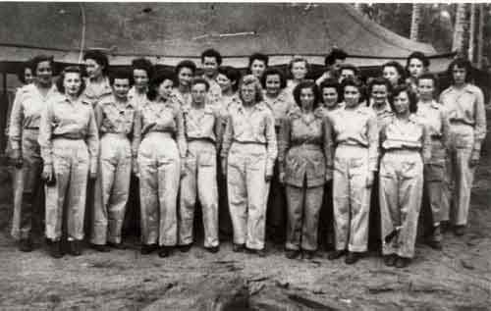
nurses
Notes:
Women had served in the Army as nurses since 1901 with the creation of the Army Nurse Corps. When the Japanese attacked Pearl Harbor on December 7th 1941 there were over 100 nurses at military bases in the Philippines. When Japanese troops invaded the Philippines some were evacuated, but 66 were captured. These nurses were interned in Manila with over 3000 U.S. and British civilians. They were finally liberated on February 3rd, 1945 after almost three years as prisoners. With the expansion of the U.S. Military, 74,000 women would eventually serve as nurses in the Army and Navy. They would serve at large hospitals in the United States, field hospitals from the deserts of North Africa to the jungles of New Guinea, aboard ships, on airplanes, and in smaller mobile hospitals all over the world.

Slide 3
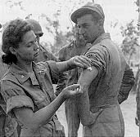
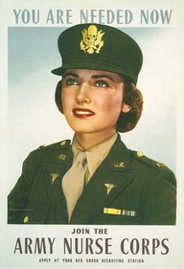
Army
Nurse
Corps
U.S. Army nurse instructs Army medics on the proper method of giving an injection, Queensland, Australia, 1942.
Notes:
More than 59,000 American nurses served in the Army Nurse Corps during World War II. Nurses worked closer to the front lines than they ever had before. Within the "chain of evacuation" established by the Army Medical Department during the war, nurses served under fire in field hospitals and evacuation hospitals, on hospital trains and hospital ships, and as flight nurses on medical transport planes. The skill and dedication of these nurses contributed to the extremely low post-injury mortality rate among American military forces in every theater of the war. Overall, fewer than 4 percent of the American soldiers who received medical care in the field or underwent evacuation died from wounds or disease.

Slide 4
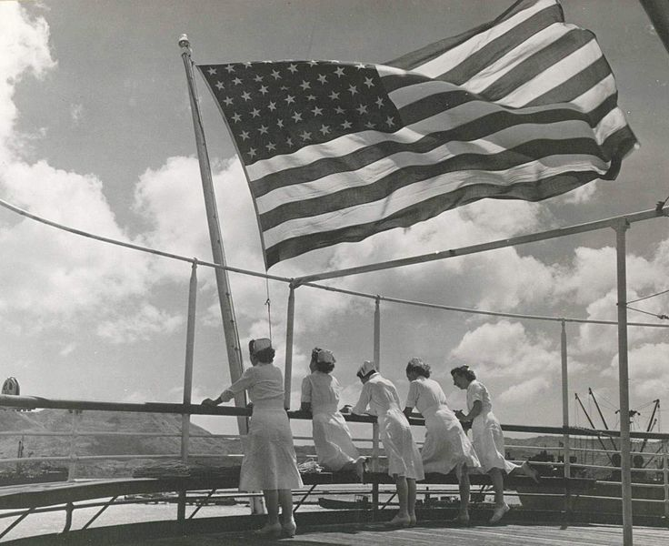
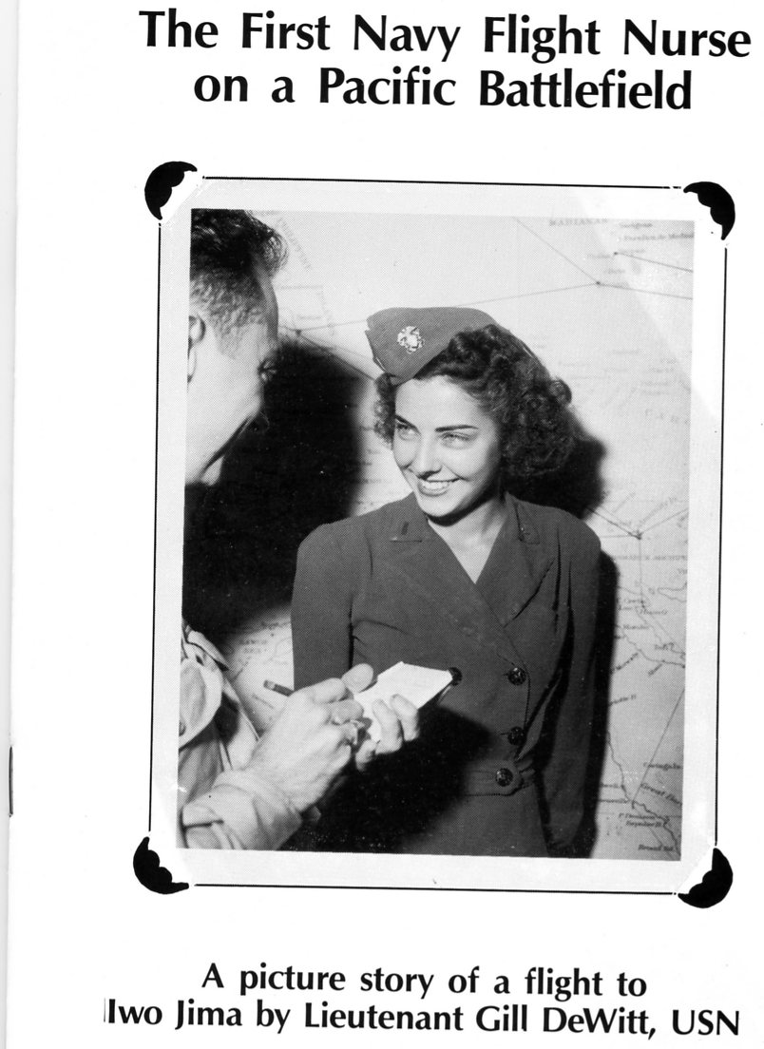
Navy Nurse
Corps
U.S. Navy nurses aboard the USS Solace
in the Pacific, 1945.
Notes:
Preparation for the conflict again saw the Nurse Corps grow, with nearly eight hundred members serving on active duty by November 1941, plus over nine hundred inactive reserves. By war's end there would be 1,799 active component nurses and 9,222 reserves (with the overwhelming number of reserves on active duty) scattered across six continents.
In the Pacific, Navy Nurses were the first American women to be sent to the islands north of New Caledonia.
The purpose of these forward operating areas was stabilization. Only when patients were fully stabilized were they sent on to Pearl Harbor, and then eventually to the United States.

Slide 5
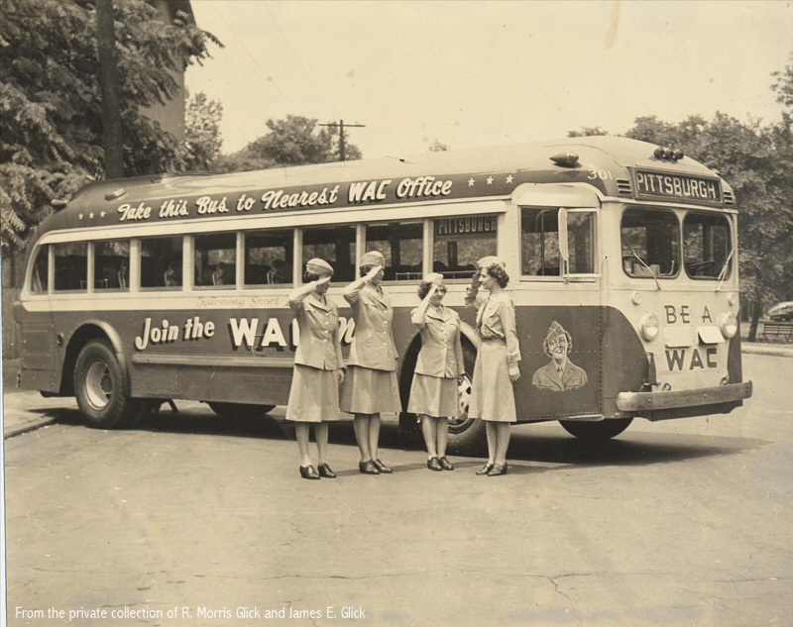
Military branches
Notes:
Due to requirements for more manpower and to free up more men to fight, Congress passed bills authorizing all branches of the service, Army, Navy, Marine Corps, and Coast Guard, to allow women to join. Chief of Staff of the Army General George C. Marshall supported the measure saying, “There are innumerable duties now being performed by soldiers that can actually be done better by women.” The Army was first to open its doors in May 1942, followed by the Navy in July, the Coast Guard in November, and the Marine Corps in January 1943. There was an initial surge of volunteers which, by 1943 had dropped off to such a level that there was discussion of drafting women. Instead, many of the original strict standards were lowered to allow more women to enter the services.

Slide 6
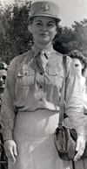
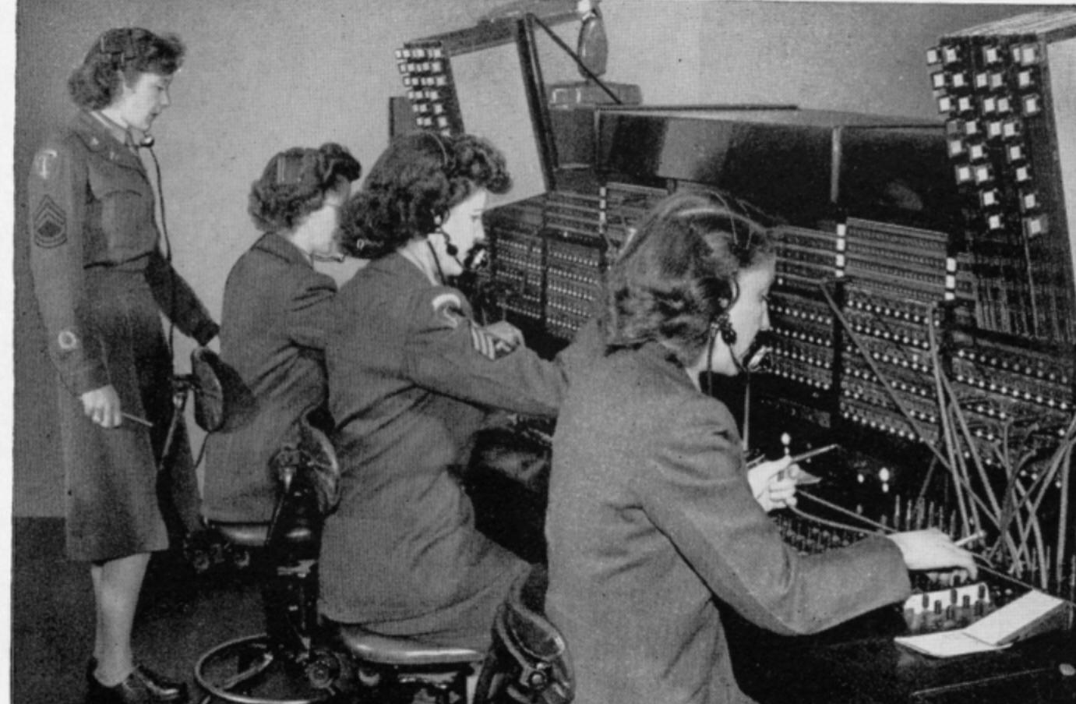
Womens’ Army
Corps (WAC)
Oveta Culp Hobby
Notes:
Originally the Women’s Army Auxiliary Corps (WAAC), the name changed to the Women’s Army Corps (WAC) in July 1943. The Director of the WAACs was Oveta Culp Hobby from Killeen and later Houston, Texas. By the end of 1943 over 60,000 women had enlisted in the Army and by the end of the war approximately 150,000 had served. While approximately half the jobs for women involved clerical work, they also served as mechanics, truck drivers, air traffic controllers, carpenters, and machinists.

Slide 7
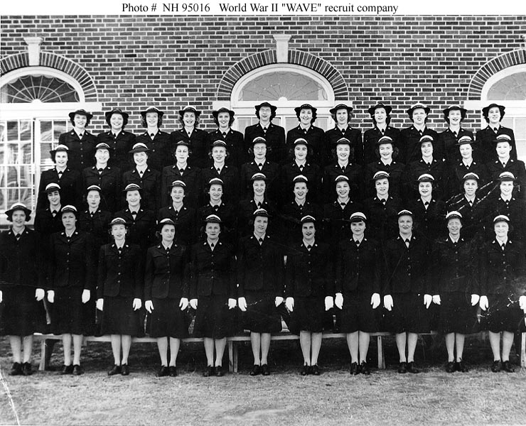
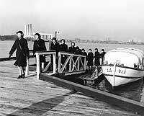
Women Accepted for
Volunteer Emergency
Service (WAVES)
Notes:
The Navy needed less women than the Army and created stricter standards for enlistment but still had no problem filling their initial quota, within a year 27,000 women wore the WAVES uniform.
These women served in a wide range of occupations. While traditionally female secretarial and clerical jobs took an expected large portion, thousands of WAVES performed previously atypical duties in the aviation community, Judge Advocate General Corps, medical professions, communications, intelligence, science and technology. The wartime Navy's demand for them was intense as it struggled to defeat Hitler and Mussolini in Europe and the Japanese in the Pacific. At the end of the conflict, there were well over 8,000 female officers and some ten times that many enlisted WAVES, about 2 ½ percent of the Navy's total strength.

Slide 8
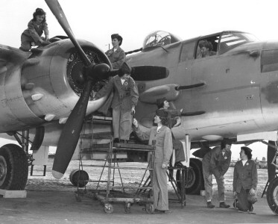
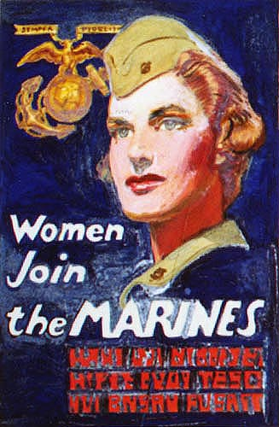
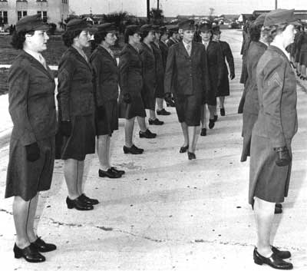
Women
Marines
Notes:
Marine Corps General Thomas Holcomb who authorized the mobilization of women into the Corps in early 1943, was emphatic that the Women Marine reservists were not to be ascribed any sort of nickname. In a March 1944 issue of Life magazine, he announced, “They are Marines. They don't have a nickname and they don't need one. They get their basic training in a Marine atmosphere at a Marine post. They inherit the traditions of Marines. They are Marines.” The women were assigned to over 200 different jobs, among them: radio operator, photographer, parachute rigger, driver, aerial gunnery instructor, cook, baker, quartermaster, control tower operator, motion picture operator, auto mechanic, telegraph operator, cryptographer, laundry operator, post exchange manager, stenographer, and agriculturist. 20,000 women joined the Marine Corps in World War II.

Slide 9
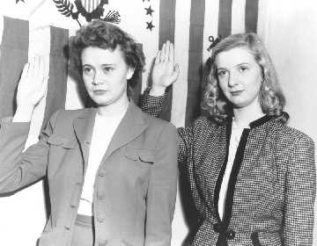
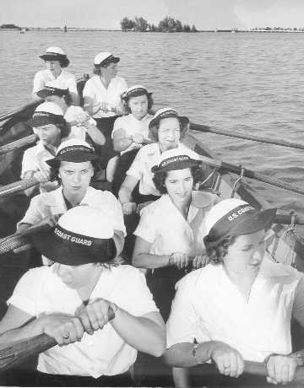
SPARS
Notes:
The Women's Reserve of the U. S. Coast Guard Reserve program (officially nicknamed the "SPARs"), was first established in 1942. LCDR Dorothy Stratton transferred from the Navy WAVES to serve as the director of the SPARs. A total of 978 women officers and 11,868 enlisted women served in the SPARs during World War II. The term SPAR came from the first letters of the Coast Guard motto in Latin and English: Semper Paratus Always Ready.

Slide 10
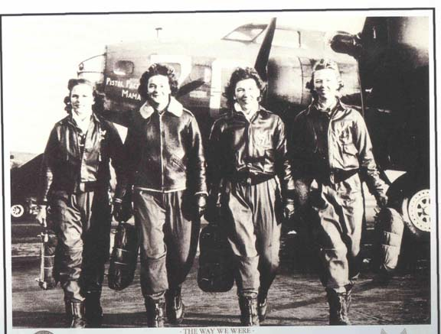
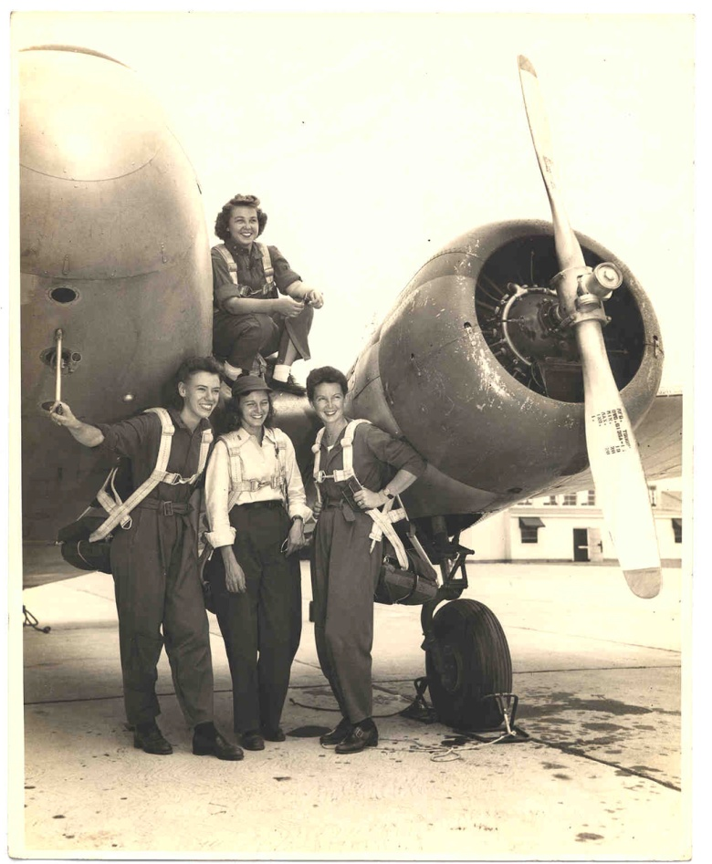
Women AirFORCE Service Pilots
(WASP)
Notes:
The Women Airforce Service Pilots (WASP) was a paramilitary aviation organization. The WASP's predecessors, the Women's Flying Training Detachment (WFTD) and the Women's Auxiliary Ferrying Squadron (WAFS) organized separately in September 1942. They were the pioneering organizations of civilian female pilots, employed to fly military aircraft under the direction of the United States Army Air Forces during World War II. The WFTD and WAFS were merged on August 5, 1943, to create the paramilitary WASP organization. The female pilots of the WASP ended up numbering 1,074, each freeing a male pilot for combat service and duties. They flew over 60 million miles in every type of military aircraft. The WASP was granted veteran status in 1977, and given the Congressional Gold Medal in 2009.
Some 25,000 women applied to join the WASP, but only 1,830 were accepted and took the oath. Only 1,074 of them passed the training and joined. Thirty-eight died flying in the WASP.

Slide 11
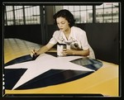
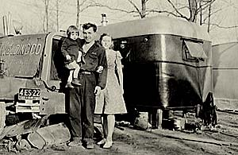
Women on the homefront
Notes:
Women joined the workforce to replace men who had joined the forces. Roosevelt stated that the efforts of civilians at home to support the war through personal sacrifice was as critical to winning the war as the efforts of the soldiers themselves. “Rosie the Riveter” became the symbol of women laboring in manufacturing. Women volunteered to work for the Red Cross, the USO and other agencies. Other women previously employed only in the home, or in traditionally female work, took jobs in factories that directly supported the war effort, or filled jobs vacated by men who had entered military service. The women who sought employment, based on various surveys and public opinion reports at the time suggests that financial reasoning was the justification for entering the labor force; however, patriotic motives made up another large portion of women's desires to enter. Women whose husbands were at war were more than twice as likely to seek jobs.

Slide 12
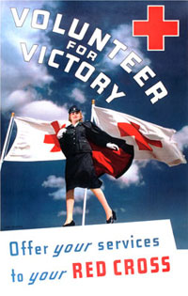
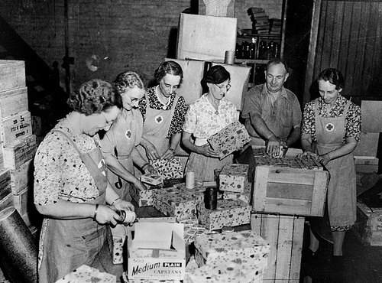
the Red Cross
Red Cross volunteers prepare Christmas packages for the
troops overseas.
Notes:
After the attack on Pearl Harbor on December 7, 1941, the Red Cross quickly mobilized a volunteer and staff force to fulfill the mandates of its 1905 congressional charter requiring that the organization “furnish volunteer aid to the sick and wounded of armies in time of war” and to “act in matters of voluntary relief and in accord with the military and naval authorities as a medium of communication between the people of the United States of America and their Army and Navy.”
At home, millions of volunteers provided comfort and aid to members of the armed forces and their families, served in hospitals suffering from severe shortages of medical staff, produced emergency supplies for war victims, collected scrap, ran victory gardens, and maintained training programs in home nutrition, first aid, and water safety. Overseas, Red Cross workers served as field directors providing compassionate support for the troops they accompanied, operated clubs and clubmobiles for the armed forces, and were attached to military hospitals, hospital ships, and hospital trains.
At the peak of Red Cross wartime activity in 1945, 7.5 million volunteers along with 39,000 paid staff provided service to the military. Throughout the war years, the Red Cross served 16 million military personnel, including one million combat casualties. By the time World War II ended in September 1945, the American public had contributed over $784 million in support of the American Red Cross. Nearly every family in America contained a member who had either served as a Red Cross volunteer, made contributions of money or blood, or was a recipient of Red Cross services.

Slide 13
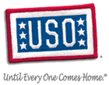
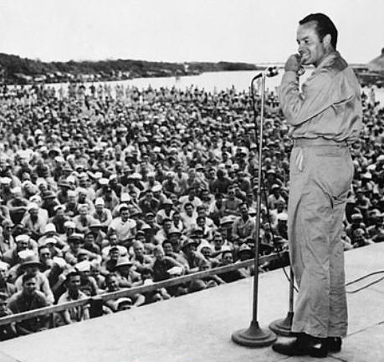
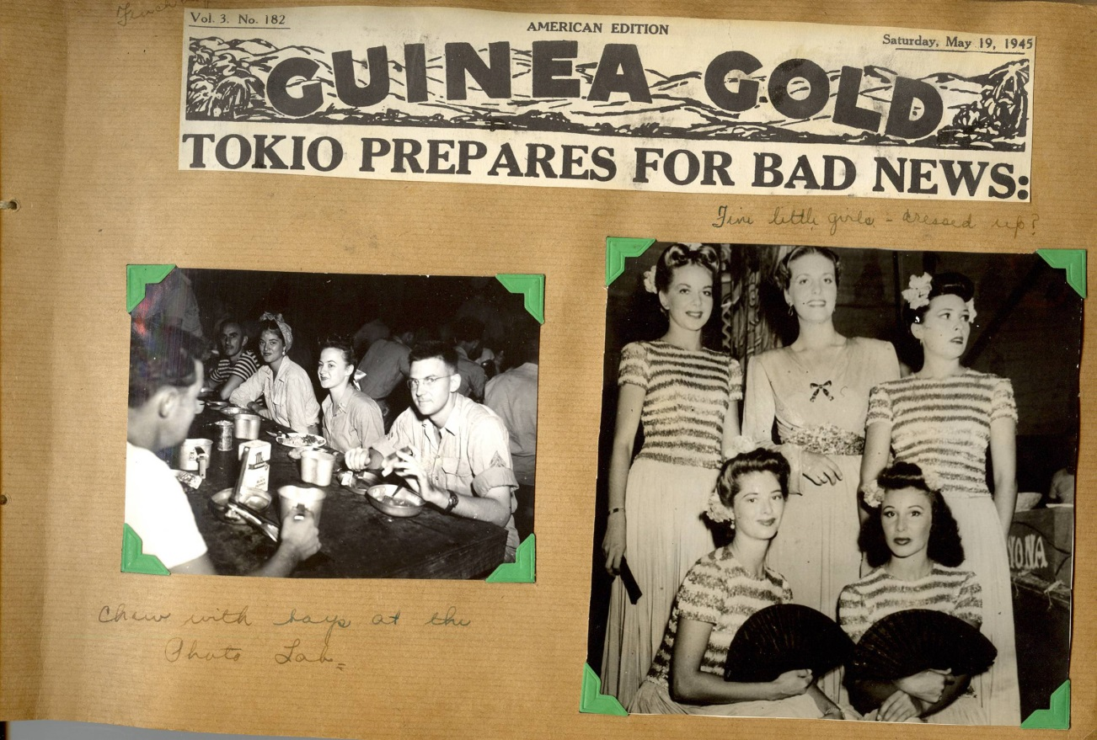
The USO
Bob Hope performs for the troops
Notes:
The USO was founded in 1941 in response to a request from President Franklin D. Roosevelt to provide morale and recreation services to U.S. uniformed military personnel. Roosevelt was elected as its honorary chairman. This request brought together six civilian organizations: the Salvation Army, Young Men’s Christian Association (YMCA), Young Women’s Christian Association (YWCA), National Catholic Community Service, National Travelers Aid Association and the National Jewish Welfare Board. They were brought together under one umbrella to support U.S. troops. After being formed in 1941, in response to World War II, "centers were established quickly... in churches, barns, railroad cars, museums, castles, beach clubs, and log cabins." Most centers offered recreational activities, such as holding dances and showing movies. And there were the well-known free coffee and doughnuts. Some USO bases provided a haven for spending a quiet moment alone or writing a letter home, while others offered spiritual guidance and made childcare available for military wives.
The organization became mostly known for its live performances called Camp Shows, through which the entertainment industry helped boost the morale of its servicemen and women. Camp Shows began in October 1941, and by that fall and winter 186 military theaters existed in the United States. Overseas shows began in November 1941 with a tour of the Caribbean. Within five months 36 overseas units had been sent within the Americas, the United Kingdom, and Australia, and during 1942 1,000 performed as part of 70 units. Average performers were paid $100 a week; top stars were paid $10 a day because their wealth let them contribute more of their talents.

Slide 14
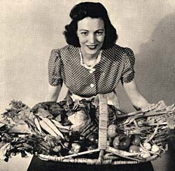
Victory Gardens
Notes:
Amid regular rationing of food in Britain, a poster campaign ("Plant more in '44!") encouraged the planting of victory gardens by nearly 20 million Americans during the course of World War II. These gardens produced up to 40% of all the vegetable produce being consumed in the USA. It was emphasized to American home front urbanites and suburbanites that the produce from their gardens would help to lower the price of vegetables needed by the US War Department to feed the troops, thus saving money that could be spent elsewhere on the military: "Our food is fighting," one US poster read. Victory gardens were planted in backyards and on apartment-building rooftops, with the occasional vacant lot "commandeered for the war effort!" and put to use as a cornfield or a squash patch.In New York City, the lawns around vacant "Riverside" were devoted to victory gardens, as were portions of San Francisco's Golden Gate Park. The slogan "grow your own, can your own", was a slogan that started at the time of the war and referred to families growing and canning their own food in victory gardens.

Slide 15
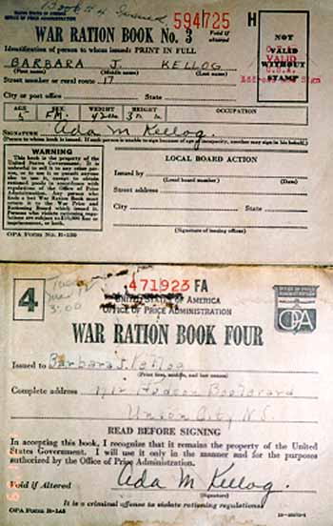
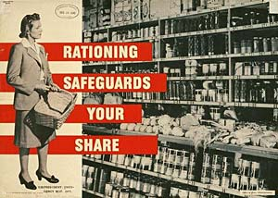
Rationing
Notes:
During the Second World War, you couldn't just walk into a shop and buy as much sugar or butter or meat as you wanted, nor could you fill up your car with gasoline whenever you liked. All these things were rationed, which meant you were only allowed to buy a small amount (even if you could afford more). The government introduced rationing because certain things were in short supply during the war, and rationing was the only way to make sure everyone got their fair share. The following items were rationed during World War II: tires, cars, bicycles, gasoline, fuel oil, kerosene, solid fuels, stoves, rubber footwear, shoes, sugar, coffee, processed foods, meats, canned fish, cheese, canned milk, fats, and typewriters. Although the United States was the largest producer of gasoline in the world, gasoline was rationed to cut down on driving to save tires. This was because the Japanese had captured the Dutch East Indies (now Indonesia), the largest producer of raw rubber in the world.

Slide 16
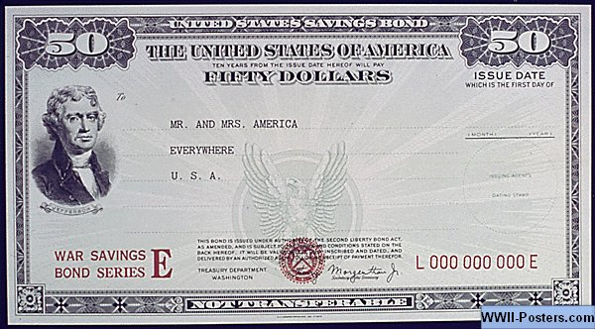
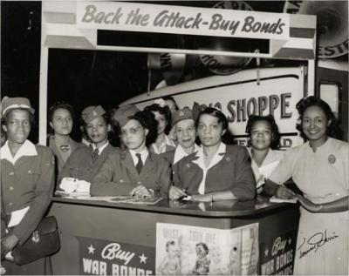
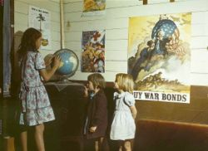
War Bonds
Notes:
War bonds are issued by a government to finance military operations and other expenditure in times of war. The bonds also remove money from circulation and thus also help to control inflation. War bonds are either retail bonds marketed direct to the public or wholesale bonds traded on a stock market. Exhortations to buy war bonds are often accompanied with appeals to patriotism and conscience. Retail war bonds, like other retail bonds, tend to have a yield which is below that offered by the market and are often made available in a wide range of denominations to make them affordable for all citizens. Both the government and citizens groups encouraged the people to buy bonds to finance the war effort.

Slide 17
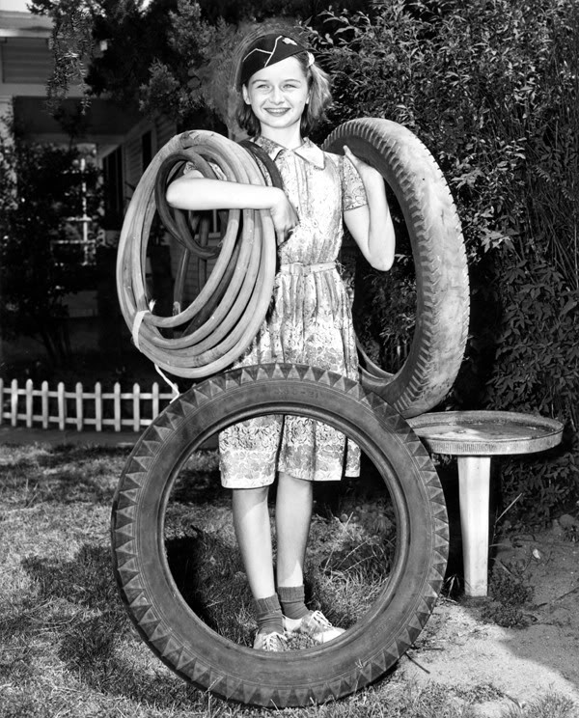
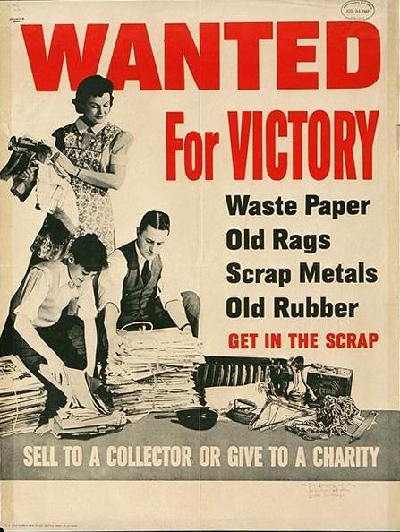
Recycling
Notes:
The U.S. Government after Pearl Harbor asked Americans to salvage and collect a long list of materials that coud be used for the war effort. The materials included paper, aluminum, copper, iron and steel, tin, rubber, silk stockings, and cooking fat. Some of these materials like rubber and silk were needed because the Japanese had cut off the supply by their rapid advance through Southeast Asia. Given the need for aluminum for aircraft production, drives were launched for old pots. One of the most serious raw material crises was rubber. The Japanese offensive in the first months of the War seized Southeast Asia which had been the major supplier of rubber. Government action requisitioned nearly the entire stock of rubber and tires. It became virtually impossible to buy tires--including bicycle and tricycle tires. Drives were launched for old tires. Major efforts were also made to expand production in Brazil and West Africa. In the end the problem was resolved by a crash program to create an entire new industry--synthetic rubber. Another interesting material was cooking fat. This might not seem like a critical national material. There are, however, many industrial uses for fats. Fat is the a base for soap. Coconut oil and palm oil are probably the most important oils used for soap, but other fats can be used as well. Fats are also used to produce candles, paints, varnishes, leather, artificial rubber, polishes, waxes, carbon paper, salves, insecticides, lubricants, cosmetics, drugs, dyes, petroleum, and synthetic resin. The reason for the drives for cooking fat, especially during the early phase of the war, was that glycerin in fat is an key ingredient in explosives. Many children participated in the various drives to collect scrap metal, used tires, fat, and newspapers. Here what was necessary was willing hands and the children had the spare time and motivation to play a role.

Slide 18
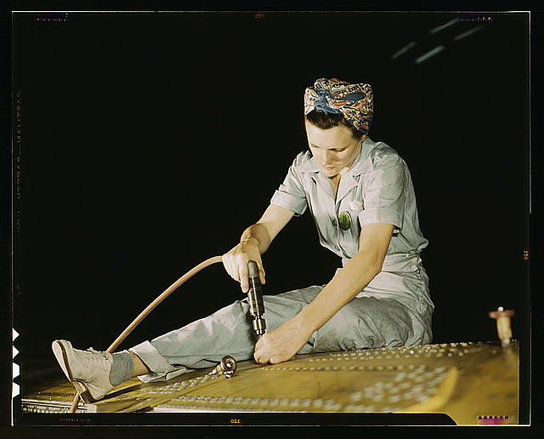
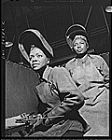
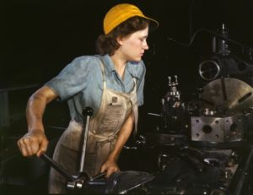
Rosie the Riveter
Notes:
Rosie the Riveter is a cultural icon of the United States, representing the American women who worked in factories during World War II, many of whom produced munitions and war supplies. These women sometimes took entirely new jobs replacing the male workers who were in the military. The term "Rosie the Riveter" was first used in 1942 in a song of the same name written by Redd Evans and John Jacob Loeb. The song was recorded by numerous artists, including the popular big band leader Kay Kyser, and it became a national hit. The song portrays "Rosie" as a tireless assembly line worker, who earned a "Production E" doing her part to help the American war effort. The name is said to be a nickname for Rosie Bonavitas who was working for Convair in San Diego, California. Women quickly responded to Rosie the Riveter, who convinced them that they had a patriotic duty to enter the workforce.

Slide 19
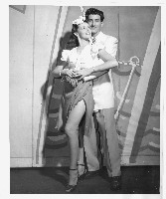
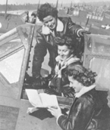
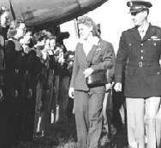
Questions ?

