Slide 1
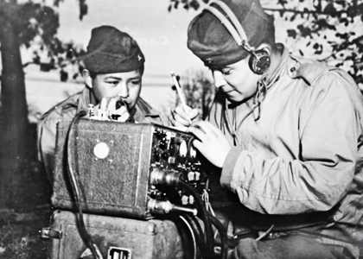
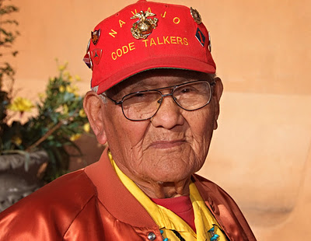
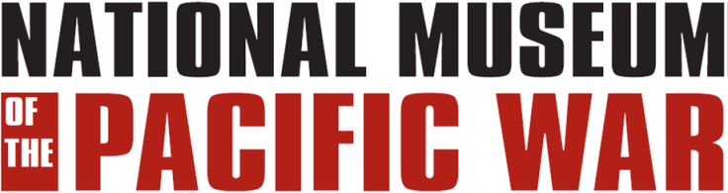
Native-american code talkers WWII
Navajo muskogee
Creek seminole
Choctaw Hopi
Sioux Comanche
Cherokee Assiniboine
Chippewa/oneida
Kiowa menominee
Pawnee
sac and fox/Meskwaki
Notes:
During WWII the U.S. military used Native Americans as “Code Talkers” because they knew that even if the enemy intercepted the transmissions they would not be able to decipher them. This was because the different tribes all had different languages and there were few non-native speakers of those languages. Although the Navajo are the most famous of the code talkers, there were at least 15 different tribes that provided men for this program.

Slide 2
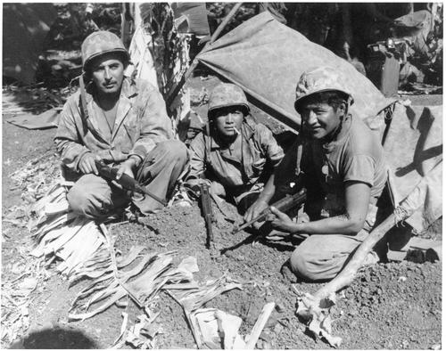
The Navajo
Navajo code talkers in the Pacific
Notes:
In 1942, there were about 50,000 Navajo tribe members. As of 1945, about 540 Navajos served as Marines. From 375 to 420 of those trained as code talkers; the rest served in other capacities.
Navajo remained potentially valuable as code even after the war. For that reason, the code talkers, whose skill and courage saved both American lives and military engagements, only recently earned recognition from the Government and the public.

Slide 3
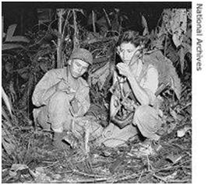
The Navajo
Receiving a message and decoding it
In the jungle
Notes:
The Japanese, who were skilled code breakers, remained baffled by the Navajo language. The Japanese chief of intelligence, Lieutenant General Seizo Arisue, said that while they were able to decipher the codes used by the U.S. Army and Army Air Corps, they never cracked the code used by the Marines. The Navajo code talkers even stymied a Navajo soldier taken prisoner at Bataan. (About 20 Navajos served in the U.S. Army in the Philippines.) The Navajo soldier, forced to listen to the jumbled words of talker transmissions, said to a code talker after the war, "I never figured out what you guys who got me into all that trouble were saying."

Slide 4
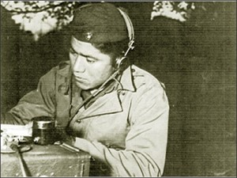
The Navajo
Navajo code talker in training
Notes:
The idea to use Navajo for secure communications came from Philip Johnston, the son of a missionary to the Navajos and one of the few non-Navajos who spoke their language fluently. Johnston, reared on the Navajo reservation, was a World War I veteran who knew of the military's search for a code that would withstand all attempts to decipher it. He also knew that Native American languages notably Choctaw had been used in World War I to encode messages.

Slide 5
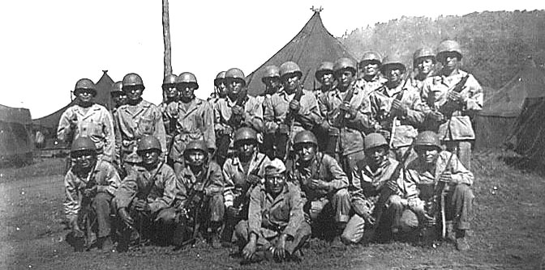
The Navajo
A group of Navajo code talkers somewhere in the Pacific
Notes:
Johnston believed Navajo answered the military requirement for an undecipherable code because Navajo is an unwritten language of extreme complexity. Its syntax and tonal qualities, not to mention dialects, make it unintelligible to anyone without extensive exposure and training. It has no alphabet or symbols, and is spoken only on the Navajo lands of the American Southwest. One estimate indicates that less than 30 non-Navajos, none of them Japanese, could understand the language at the outbreak of World War II.

Slide 6
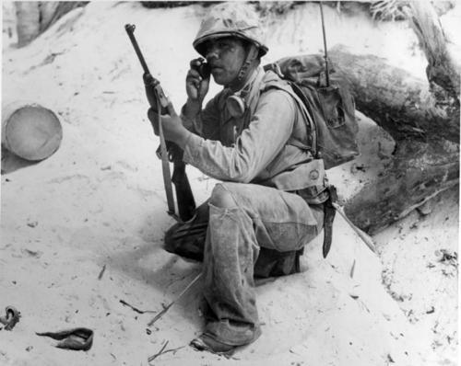
The Navajo
Sending a message during a battle
Notes:
The Navajo Code Talker's Dictionary:
When a Navajo code talker received a message, what he heard was a string of seemingly unrelated Navajo words. The code talker first had to translate each Navajo word into its English equivalent. Then he used only the first letter of the English equivalent in spelling an English word. Thus, the Navajo words "wol-la-chee" (ant), "be-la-sana" (apple) and "tse-nill" (axe) all stood for the letter "a." One way to say the word "Navy" in Navajo code would be "tsah (needle) wol-la-chee (ant) ah-keh-di- glini (victor) tsah-ah-dzoh (yucca)."

Slide 7
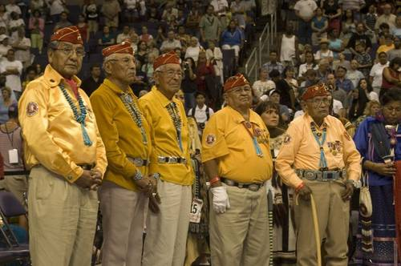
The Navajo
Veteran code talkers being honored at a ceremony
Notes:
Most letters had more than one Navajo word representing them. Not all words had to be spelled out letter by letter. The developers of the original code assigned Navajo words to represent about 450 frequently used military terms that did not exist in the Navajo language. Several examples: "besh- lo" (iron fish) meant "submarine," "dah-he- tih-hi" (hummingbird) meant "fighter plane" and "debeh-li-zine" (black street) meant "squad."

Slide 8
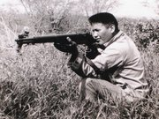
Other Tribes
A Meskwake tribesman from Iowa in training
Notes:
Meskwake men used their language against the Germans in North Africa. Twenty-seven Meskwaki, then 16% of Iowa's Meskwaki population, enlisted in the U.S. Army together in January 1941

Slide 9
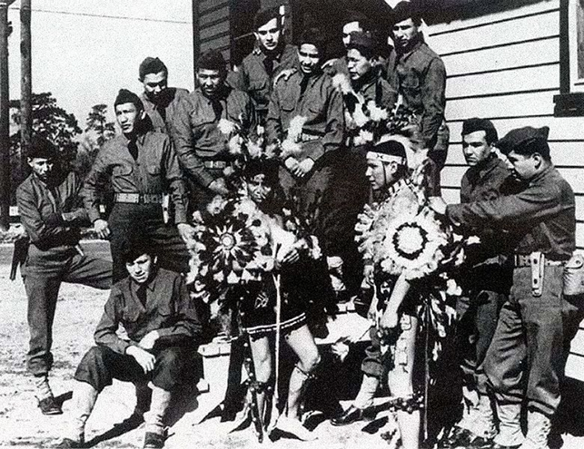
Other Tribes
Comanches from the Army’s 4th Infantry Division
Notes:
Comanches of the 4th Signal Company compiled a vocabulary of over 100 code terms using words or phrases in their own language. Using a substitution method similar to the Navajo, the Comanche code word for tank was "turtle", bomber was "pregnant airplane", machine gun was "sewing machine" and Adolf Hitler became "crazy white man”.

Slide 10
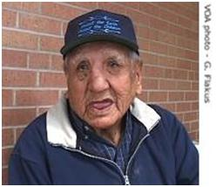
Other Tribes
Clarence Wolf Guts, Lakota Sioux
Notes:
September 27, 2007 – Pine Ridge, South Dakota – The language is Lakota, one of three dialects of the people collectively called Sioux. The language is divided into three dialects – Dakota, Nakota and Lakota – but any person who speaks one dialect can understand the others.
Clarence Wolf Guts is an 83-year-old Lakota warrior whose ability to speak his native language played a role in defeating the Japanese in World War II.
“I helped win the war, I helped, me and my buddies,” he said.
With a surname that many non-Indians in the US military found amusing, Clarence Wolf Guts took his fair share of teasing, but he soon found himself assigned with other Lakota speakers to a special unit. The so-called code talkers would send and receive messages in their language. Similar programs were operated by the U.S. Marines using mainly Navajo speakers. The Japanese were never able to understand the messages.

Slide 11
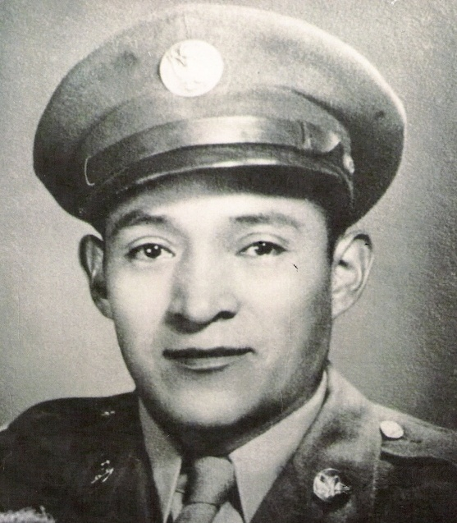
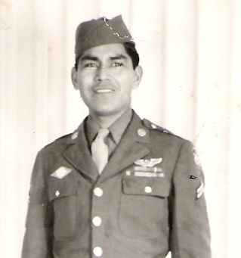
Other Tribes
Rex Pooyouma (left) and Orville Wadsworth, Hopi code talkers
Notes:
Rex Pooyouma was identified by the U.S. Army Center of Military Studies in September 2010, as a Hopi Code Talker. In October 2010, documentation was provided that also identified Orville Wadsworth as the 10th Hopi Code Talker.
During WWII, Pooyouma (on the left) was assigned to the ground staff at Group Headquarters in the 380th. Wadsworth (on the right) was assigned to the 90th Bombardment Group. Both were selected and trained as part of a secret Native American Code Talker communications network to transmit secret-coded messages, using their Hopi Lavayii, in the Pacific campaign.

Slide 12
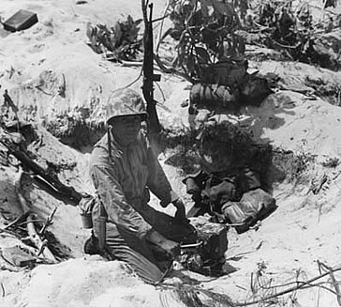
Did you get the message?
Notes:
During WWII, Native Americans used as Code Talkers played a vital role in keeping important information from the enemy. They served in both the European and Pacific theaters of war and aiding in the Allied victory over Germany and Japan. Do you have any questions?

